Slide 1
Introduction to Lisp
Peter D. Karp, Ph.D.
Bioinformatics Research Group
SRI International
pkarp@ai.sri.com

Slide 2
Approx presentation time along with hello.lisp: 1.5 hrs

Slide 3
Common Lisp Programming Environment
Interpreted and/or compiled execution
Interactive data exploration
Fabulous debugging environment
High-level language
Extensive built-in libraries: XML, regexps
Dynamic redefinition
Find out more!
See ALU.org or
http://www.international-lisp-conference.org/

Slide 4
Why Do We Code in Common Lisp?
Gatt studied Lisp and Java implementation of 16 programs by 14 programmers (Intelligence 11:21 2000)
The average Lisp program ran 33 times faster than the average Java program
The average Lisp program was written 5 times faster than the average Java program
Roberts compared Java and Lisp implementations of a Domain Name Server (DNS) resolver
http://www.findinglisp.com/papers/case_study_java_lisp_dns.html
The Lisp version had ½ as many lines of code

Slide 5
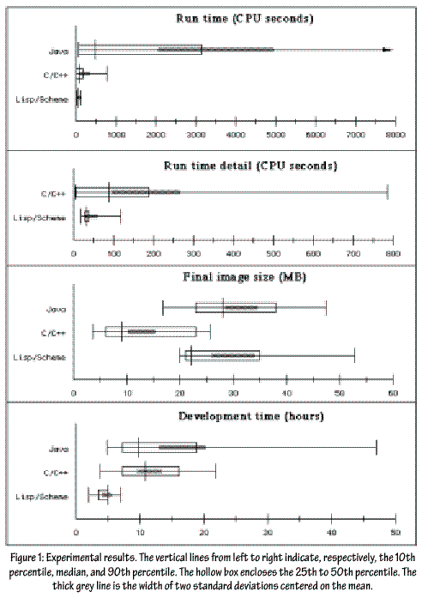
The Common Lisp Programming Environment
Gatt studied Lisp and Java implementation of 16 programs by 14 programmers (Intelligence 11:21 2000)

Slide 6
Peter Norvig’s Solution
“I wrote my version in Lisp. It took me about 2 hours (compared to a range of 2-8.5 hours for the other Lisp programmers in the study, 3-25 for C/C++ and 4-63 for Java) and I ended up with 45 non-comment non-blank lines (compared with a range of 51-182 for Lisp, and 107-614 for the other languages). (That means that some Java programmer was spending 13 lines and 84 minutes to provide the functionality of each line of my Lisp program.)”
http://www.norvig.com/java-lisp.html

Slide 7
Interacting with Lisp
Read-eval-print loop
Load file of code into Lisp image
Use Emacs to incrementally redefine functions
hello.lisp

Slide 8
Lisp Images -- dumplisp
Load code and data into Lisp virtual memory
Save as executable binary file

