Slide 1
From annotated genomes to metabolic flux models
Jeremy Zucker
Computational Biologist
Broad Institute of MIT and Harvard

Slide 2
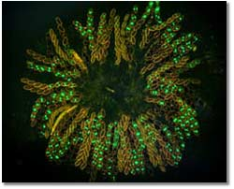
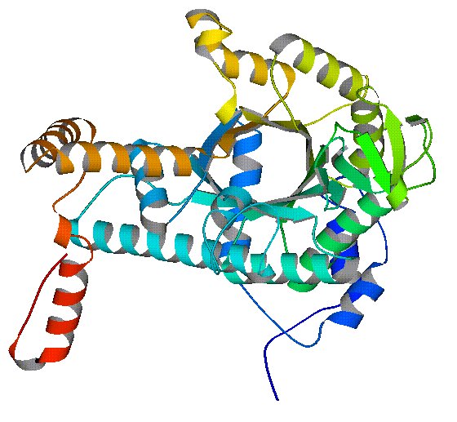
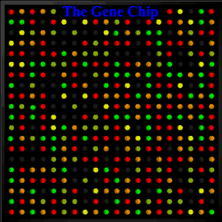
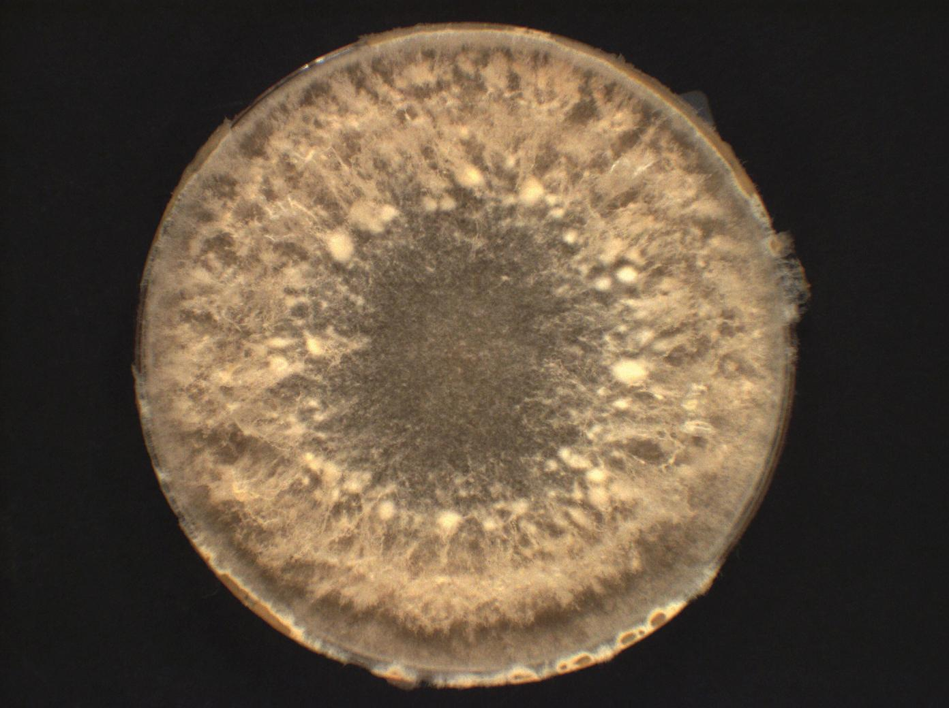
From functional annotation to system modeling
Enzyme predictor
Pathway predictor
Model
Omics data
Predictions

Slide 3
From genomes to EC numbers
How EFICAz works
Can it do better than prediction by homology transfer? 90% precision=60% sequence identity
Conclusions and future directions

Slide 4
CHIEFc family based FDR recognition: detection of Functionally Discriminating Residues (FDRs) in enzyme families obtained by a Conservation-controlled HMM Iterative procedure for Enzyme Family classification (CHIEFc),
Multiple Pfam family based FDR recognition: detection of FDRs in combinations of Pfam families that concurrently detect a particular enzyme function,
CHIEFc family specific SIT evaluation: pairwise sequence comparison using a CHIEFc family specific Sequence Identity Threshold (SIT), and
High specificity multiple PROSITE pattern recognition: detection of multiple PROSITE patterns that, taken all together, are specifically associated to a particular enzyme function.

Slide 5
What is EFICAz?
Enzyme Function Inference by a Combined Approach (EFICAz)
Training sets of EC classifications
Enzymes->EC: Uniprot/Swiss-Prot release 10 and 13
HMM->EC: PFAM release 22
Sets of Domains->EC: PROSITE 20.26 and 20.30
Machine learning algorithms for EC classifications.
Functionally discriminating residues
Support vector machines
Family specific sequence identity thresholds
Decision trees

Slide 6
What is an FDR?

Slide 7
What is an SVM?

Slide 8
What are the EFICAz components?
Functionally discriminating residues;
CHIEFc family-based FDR recognition Conservation-controlled HMM Iterative procedure for Enzyme Family classification
Multiple Pfam family based FDR recognition
Support Vector machines:
CHIEFc family based SVM evaluation
Multiple Pfam family based SVM evaluation
Sequence Identity threshold:
CHIEFc family specific SIT evaluation
High specificity multiple PROSITE pattern recognition

Slide 9
How are EFICAz components combined?

Slide 10
How does EFICAz compare vs SIT?

Slide 11
From functional annotation to system modeling
Enzyme predictor
Pathway predictor
Model
Omics data
Predictions

Slide 12
What can you do with a Flux-balanced model of Metabolism?
Omics integration
E-flux
metabolomics
Phenotype predictions
Biolog
Gene KO
Metabolic engineering
Biofuel optimization
Drug targeting
Host-pathogen interactions
Macrophage-TB
TB-mycobacteriophage
But first, you need a reliable model!

Slide 13
Algorithms for Debugging Metabolic Networks
Metabolic network is too complicated.
The metabolic network is infeasible.
E-flux results in dead model.

Slide 14
Minimal Organism
Given a feasible model under the given nutrient conditions, find the fewest number of nonzero fluxes that still results in a viable organism.
minimize card(v)
subject to:
Sv = 0,
l <= v <= u

Slide 15
Minimal Reaction Adjustment
Given an infeasible model, find a reaction with the smallest number of reactants and products that results in a feasible model.
minimize card( r )
subject to
Sv + r = 0
l <= v <= u

Slide 16
Minimal Limit Adjustment
Given a set of (feasible) baseline limits, and an (infeasible) set of expression-constrained flux limits, find the smallest number of adjustments to the flux limits that results in feasible model (without exceeding the baseline constraints).
minimize card(dl) + card(du)
subject to:
Sv = 0,
l – dl <= v <= u+du
l-dl >= l_0, u+ du <= u_0
dl >= 0, du >= 0.

Slide 17
Minimum Cardinality
Each of these problems is a special case of the minimum cardinality problem
Minimize card( x )
Subject to
Ax + By >= f
Cx + Dy = g
Caveat: the minimum cardinality problem is NP-Hard!

Slide 18
Sparse Optimization to the rescue!
Recent results from Compressed Sensing have shown that minimizing the L1-norm is a decent heuristic
Iterative methods can improve the results
Instead of minimize card( x ),
Minimize norm(diag(w) x, 1) = sum(w_i |x_i| )
Update w_i = 1/(epsilon + |x_i|), i=1,…,k

Slide 19
Implementations
3 software packages in matlab
Cvx (Sedumi and spdt3)
Glpkmex (GLPK)
Cplexmex (CPLEX)
min cardinality
MILP and L1 heuristic version
min limit adjustment
MILP and L1 heuristic version
Min limit adjustment => min cardinality

Slide 20
From functional annotation to system modeling
Enzyme predictor
Pathway predictor
Model
Omics data
Predictions

Slide 21
Applications of PathwayTools
Tuberculosis - NIAID
Biofuels – Neurospora, Rhodococcus
Metagenomics – Human Microbiome Project

Slide 22
Comprehensive Biochemical and Transcriptional Profiling for TB
in vitro Cultures
Mtb-Infected
Macrophage Cultures
ChIP-Seq
Transcriptomics
Glycomics
Proteomics
Lipidomics
Metabolomics
Computational Regulatory and Metabolic Network Modeling
Data and Models Deposited In TBSysBio Database

Slide 23
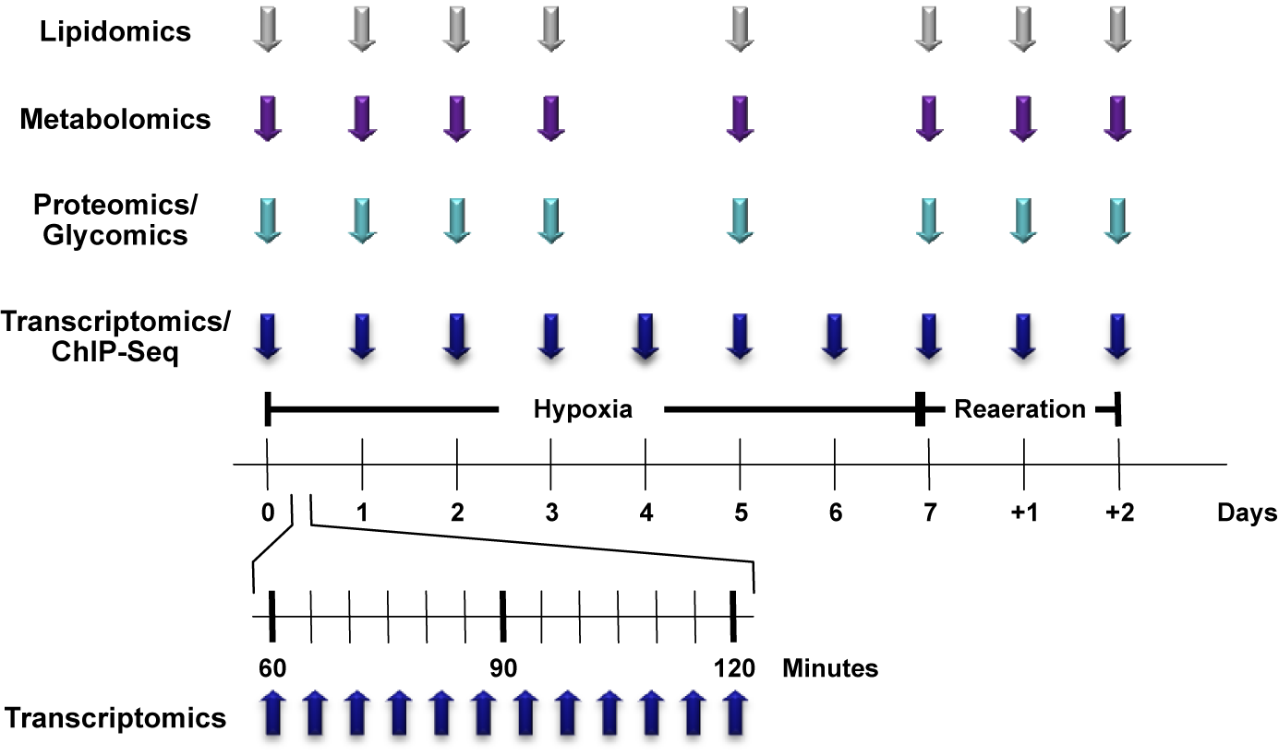
An In vitro Oxygen Limitation Model
Progression Into and Out Of Non-Replicating Persistence
Aerated
Culture
Early/Late Time Points
Monitor Adaptation
To A New State

Slide 24
Biofuels from Neurospora?
Growing interest for obtaining biofuels from fungi
Neurospora crassa has more cellulytic enzymes than Trichoderma reesei
N. crassa can degrade cellulose and hemicellulose to ethanol [Rao83]
Simultaneous saccharification and fermentation means that N. crassa is a possible candidate for consolidated bioprocessing
Xylose
Ethanol

Slide 25
Effects of Oxygen limitation on Xylose fermentation in Neurospora crassa
Xylose
Intermediate O₂
Glycolysis
Ethanol conversion (%)
Pyruvate
Respiration
Fermentation
Low O₂
TCA
Ethanol
High O₂
Oxygen level (mmol/L*g)
Zhang, Z., Qu, Y., Zhang, X., Lin, J., March 2008. Effects of oxygen limitation on xylose fermentation, intracellular metabolites, and key enzymes of Neurospora crassa as3.1602. Applied biochemistry and biotechnology 145 (1-3), 39-51.

Slide 26
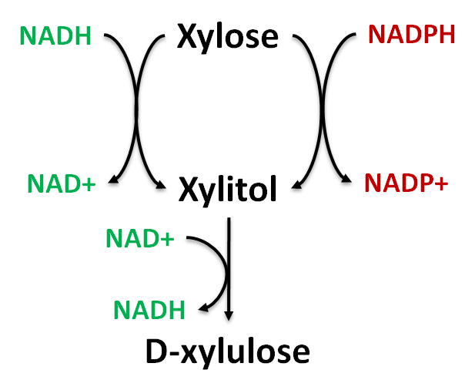
Pentose phosphate
Xylose degradation
Xylose
Two paths from xylose to xylitol
Glycolysis
Model of Xylose
Fermentation
Aerobic respiration
Fermentation
Oxygen
Ethanol
TCA Cycle
ATP

Slide 27
Pentose phosphate
Xylose degradation
High
Oxygen
NADPH
Regeneration
Glycolysis
NADPH &
NAD⁺
Utilization
Aerobic respiration
Fermentation
Oxygen=5
NAD⁺
Regeneration
TCA Cycle
ATP=16.3

Slide 28
Pentose phosphate
Xylose degradation
Low
Oxygen
Glycolysis
Aerobic respiration
Fermentation
Oxygen=0
Ethanol
TCA Cycle

Slide 29
Pentose phosphate
Xylose degradation
Intermediate
Oxygen
Optimal
Ethanol
NADPH
Regeneration
Glycolysis
NADPH &
NAD
Utilization
Aerobic respiration
Fermentation
Oxygen=0.5
All O₂ used to regenerate NAD used in first step
Ethanol
NAD
Regeneration
TCA Cycle
ATP=2.8

Slide 30
Pentose phosphate
Xylose degradation
Improve NADH
enzyme
Intermediate
Oxygen
Optimal
Ethanol
NADPH
Regeneration
Glycolysis
NADPH &
NAD
Utilization
Bottleneck
Pyruvate
decarboxylase
Aerobic respiration
Fermentation
Oxygen=0.5
All O₂ used to regenerate NAD used in first step
Ethanol
NAD
Regeneration
TCA Cycle
ATP=2.8

Slide 32
Human microbiome project
Str
St

Slide 33
Take home
What is the future of EFICAz?
http://sites.google.com/site/adriansfamilyorg/
Expect a paper soon on debugging the bug
Expect a lot of analysis of TB
Neurospora FBA model
HMP analysis

Slide 34
Acknowledgements
Galagan Lab
Aaron Brandes
Chris Garay
Jason Holder
Stephen Boyd
Peter Karp
Bernhard Palsson

