Slide 1



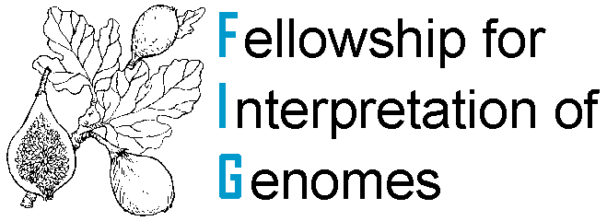
Model SEED Resource for the Generation, Optimization, and Analysis of Genome-scale Metabolic Models
Christopher Henry, Matt DeJongh, Aaron Best, Ross Overbeek, and Rick Stevens
Presented by: Christopher Henry
Pathway Tools Workshop
October, 2010

Slide 2
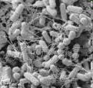
Metabolic Modeling is One Key to Predicting Phenotype from Genotype
What is a metabolic model?
1.) A list of all reactions involved in the metabolic pathways
2.) A list of rules associating reaction activity to gene activity
3.) A biomass reaction listing essential building blocks needed for growth and division
Gene A
Gene B
Function
Function
Nutrients
Enzyme
Amino acids
Nucleotides
Lipids
Cofactors
Biomass
Cell walls
Energy

Slide 3
Metabolic Modeling is One Key to Predicting Phenotype from Genotype
What can a metabolic model do?
1.) Predict culture conditions and possible responses to environment changes.
2.) Predict metabolic capabilities from genotype.
3.) Predict impact of genetic perturbations
Gene A
Gene B
Function
Function
Nutrients
Byproducts
Enzyme
Amino acids
Nucleotides
Lipids
Cofactors
Biomass
Cell walls
Energy

Slide 4





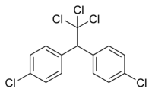

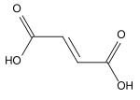
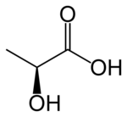
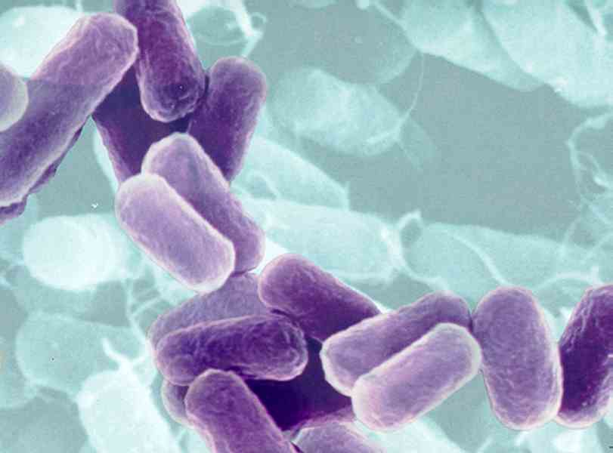
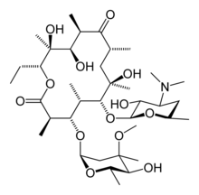

Why Metabolic Modeling? Putting microorganisms to work in industry
Bioremediation
Biofuels
acetoacetate
succinate
ethanol
pyruvate
butanol
DDT
fumarate
erythromycin
lactic acid
1,3-propanediol
Biosynthesis

Slide 5

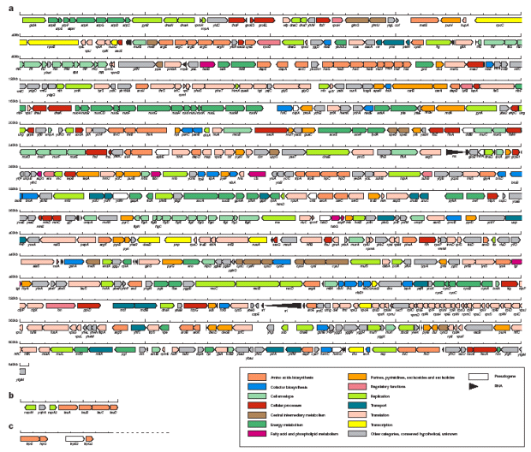
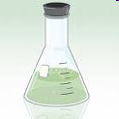
Metabolic Modeling is One Key to Predicting Phenotype from Genotype
What can a metabolic model do?
1.) Predict culture conditions and possible responses to environment changes.
2.) Predict metabolic capabilities from genotype.
3.) Predict impact of genetic perturbations
4.) Linking annotations to observed organism behavior enabling validation and correction of annotations
MODEL
Biomass
ANNOTATION
PREDICTION
PHENOTYPE
RECONCILIATION

Slide 6
Flux Balance Analysis
The Cell
C
Nutrient
3
4
Biomass
1
A
2
B
5
D
6
7
By product
Assuming Steady State:
At Steady State:
No internal metabolite is allowed to accumulate
v₁ = v₂
v₂ =v₃+v₅+v₇
Thus, reaction rates are constrained by mass balances
v₃ = v₄
For example:
v₄+v₅ = v₆
www.theseed.org/models/

Slide 7
Flux Balance Analysis
The Cell
C
Nutrient
3
4
Biomass
1
A
2
B
5
D
6
7
V
By product
1
2
3
4
5
6
7
A
B
C
D
www.theseed.org/models/

Slide 8
Model reconstruction lags behind genome sequencing
Sequenced prokaryotes in NCBI
Automatically generated SEED models
Number of genomes
Total published models
Number of models
Manually curated published models
≈1000 completely sequenced prokaryotes vs ≈30 published genome-scale models
Models are often constructed one-at-a-time by individuals working independently
Model building typically begins by identifying bidirectional best hits with E. coli
Current process results in replication of work, propagation of errors, and extensive manual curation
Bottom line: it currently requires approximately one year to produce a complete model
www.theseed.org/models/

Slide 9
Model SEED: Converting Annotated Genomes into Genome-scale Metabolic Models
RAST annotation server

Slide 10
What is SEED?
SEED is comparative genomics and annotation environment focused on facilitating high-throughput annotation curation
Annotation, comparison, and curation are centered on Subsystems
Subsystems are collections of biological functions similar to KEGG pathways (e.g. glycolysis) but not limited to metabolic functions
In SEED, strict controlled vocabulary is enforced for all biological functions included in subsystems
Annotations are propagated using curated families of iso-functional homologs called FIGfams
SEED and are part of an effort to consistently annotate all sequenced prokaryotes
Notes:
Using a strategy of subsystems annotation, NMPDR provides researchers with corrected functional annotations in a structured biological context. Hundreds of distinct subsystems have been developed to describe central and secondary metabolism, complex structures, and virulence or other phenotypes. Tools for comparative analysis allow investigators to discover emergent properties in complex systems.

Slide 11
What is Subsystem?
A subsystem is a set of closely coupled biological functions that typically co-occur and are often clustered on a genome

Slide 12
FIGfam Protien Families Within the SEED
FIGfams are an attempt to form sets of proteins
performing the same cellular function
FIGfams have end to end homology
FIGfams come from two sources
(1) manually curated Subsystems
(2) “close strains” and “conserved clusters”
  Aligning two very similar genomes, with confidence establish a correspondence between genes in a region
  If proximity on the chromosome has been preserved over many genomes, we believe the proteins in that region play the same functional role
Notes:
Using a strategy of subsystems annotation, NMPDR provides researchers with corrected functional annotations in a structured biological context. Hundreds of distinct subsystems have been developed to describe central and secondary metabolism, complex structures, and virulence or other phenotypes. Tools for comparative analysis allow investigators to discover emergent properties in complex systems.

Slide 13
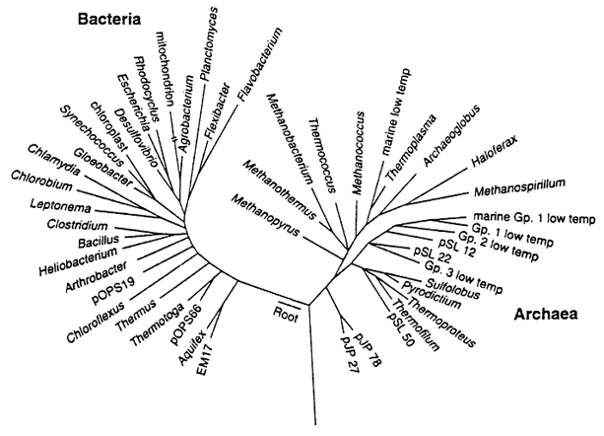
High-throughput Annotation with RAST
Use set of universal genes to find taxonomic neighborhood
  Find universal in new genome (using ORF superset)
  Find set of neighbors based on similarity to universal
Universal genes
"Phenylalanyl-tRNA synthetase beta chain (EC 6.1.1.20)”
"Prolyl-tRNA synthetase (EC 6.1.1.15)”
"Phenylalanyl-tRNA synthetase alpha chain (EC 6.1.1.20)”
"Histidyl-tRNA synthetase (EC 6.1.1.21)”
"Arginyl-tRNA synthetase (EC 6.1.1.19)”
"Tryptophanyl-tRNA synthetase (EC 6.1.1.2)”
"Preprotein translocase secY subunit (TC 3.A.5.1.1)”
"Tyrosyl-tRNA synthetase (EC 6.1.1.1)”
"Methionyl-tRNA synthetase (EC 6.1.1.10)”
"Threonyl-tRNA synthetase (EC 6.1.1.3)”
"Valyl-tRNA synthetase (EC 6.1.1.9)”
We only compute neighbors, no full phylogeny
Notes:
The computationally expensive “all against all” BLASTing is replaced with targeted searches using a set of representative sequences from FIGfams as queries (this collection currently includes ~100,000 protein families):
Input: prokaryotic genome in a set of contigs in FASTA or GenBank format
Step 1: calling the tRNA and rRNA genes
Step 2: preliminary “quick and dirty” effort to call protein-encoding genes
Step 3: Establishing phylogenetic context:
Representative sequences from a small set of FIGfams, which are ubiquitous in prokaryotes, are used to BLAST the new genome. Outcome: a small set of genes (8–15) that can be used to estimate the phylogenetic “neighborhood”
Each of these genes is used to BLAST the corresponding FIGfam to determine the ~10 closest phylogenetic neighbors of the submitted genome
Step 4: Targeted search of the new genome based on FIGfams that occur in closely related genomes:
Each gene found is moved from the set of putative genes to the set of determined genes, its starting position is adjusted, it is annotated with the function projected from the FIGfam (consistency)
Step 5: Recalling ORFs accurately using accumulated set of determined genes as a training set
Step 6: Processing the remaining genes against the entire FIGfam collection
Step 7: Cleaning up remaining gene calls to remove overlaps and adjust starting positions:
Remaining putative genes are BLASTed against a large non-redundant protein database. This step represents most of the overhead in a RAST annotation. By first processing a majority of the genes using FIGfam-based technology and focused searches, this cost is minimized without reducing accuracy.

Slide 14
High-throughput Annotation with RAST
Use set of universal genes to find taxonomic neighborhood
  Find universal in new genome (using ORF superset)
  Find set of neighbors based on similarity to universal
Find candidate protein functions from neighbors
  Extract all proteins in subsystems
  Extract all remaining proteins
  We use FIGfams for this purpose
List of subsystems
FIGfams
List of proteins outside Subsystems
FIGfams

Slide 15
High-throughput Annotation with RAST
Use set of universal genes to find taxonomic neighborhood
  Find universal in new genome (using ORF superset)
  Find set of neighbors based on similarity to universal
Find candidate protein functions from neighbors
  Extract all proteins in subsystems
  Extract all remaining proteins
    We use FIGfams for this purpose
Search for instances of candidate functions in genome
    First proteins in subsystems, then remaining proteins
  Search FIGfams in genome
  typical genome: 2-7 million bases, 2000 – 7000 proteins

Slide 16
High-throughput Annotation with RAST
Use set of universal genes to find taxonomic neighborhood
  Find universal in new genome (using ORF superset)
  Find set of neighbors based on similarity to universal
Find candidate protein functions from neighbors
  Extract all proteins in subsystems
  Extract all remaining proteins
  We use FIGfams for this purpose
Search for instances of candidate functions in genome
  First proteins in subsystems, then remaining proteins
Search any remaining ORFs against SEED nr database
  Search ORFs in SEED non-redundant (nr) database
  SEED-nr several gigabases and millions of proteins

Slide 17
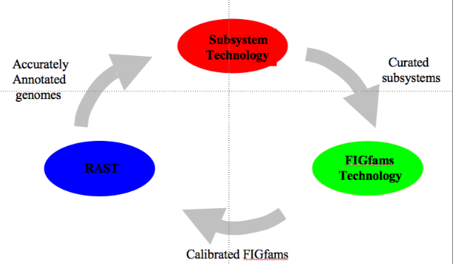
Iterative Annotation in the SEED
Accurately annotated core of diverse genomes
Subsystems that are manually curated across the entire collection of genomes
Within the subsystems, annotators assign functions to FigFams of iso-functional homologues, facilitating annotation propagation
Notes:
Using a strategy of subsystems annotation, NMPDR provides researchers with corrected functional annotations in a structured biological context. Hundreds of distinct subsystems have been developed to describe central and secondary metabolism, complex structures, and virulence or other phenotypes. Tools for comparative analysis allow investigators to discover emergent properties in complex systems.

Slide 18
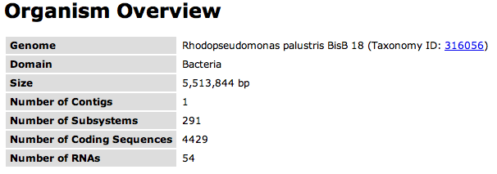
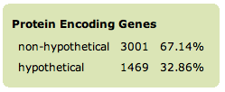
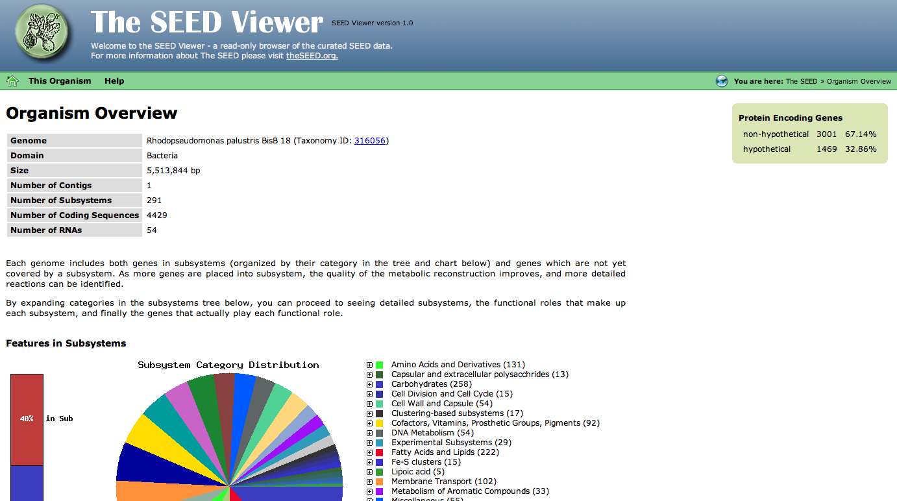
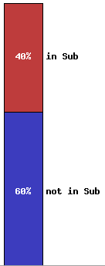
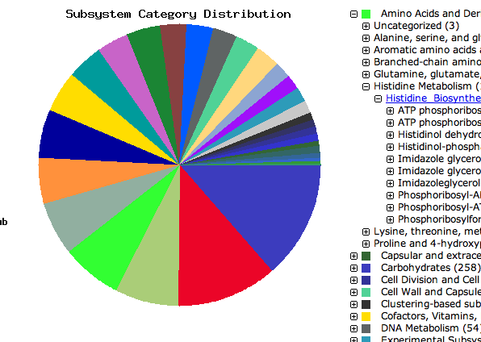
SeedViewer - Genome Overview Page
% hypotheticals
Overview statistics
% in subsystems
Metabolic overview
Notes:
Using a strategy of subsystems annotation, NMPDR provides researchers with corrected functional annotations in a structured biological context. Hundreds of distinct subsystems have been developed to describe central and secondary metabolism, complex structures, and virulence or other phenotypes. Tools for comparative analysis allow investigators to discover emergent properties in complex systems.

Slide 19
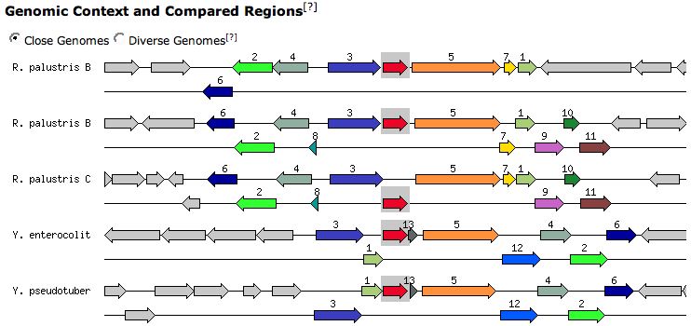
Explore genomic context
pin
Rhodopseudomonas palustris BisB 18
Rhodopseudomonas palustris BisB 5
Rhodopseudomonas palustris CGA009
Yersinia enterocolitica 8081
Yersinina pseudotuberculosis IP 32953
Highlight similarities with related genomes
Centered on single gene (pin), shows region in other genomes with similar gene load
Genes with identical color (and number) are homologous
Light grey genes have no sequence similarity
Notes:
Using a strategy of subsystems annotation, NMPDR provides researchers with corrected functional annotations in a structured biological context. Hundreds of distinct subsystems have been developed to describe central and secondary metabolism, complex structures, and virulence or other phenotypes. Tools for comparative analysis allow investigators to discover emergent properties in complex systems.

Slide 20
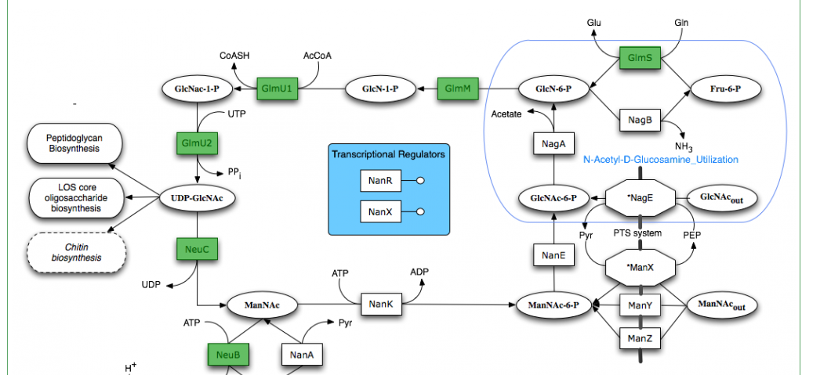
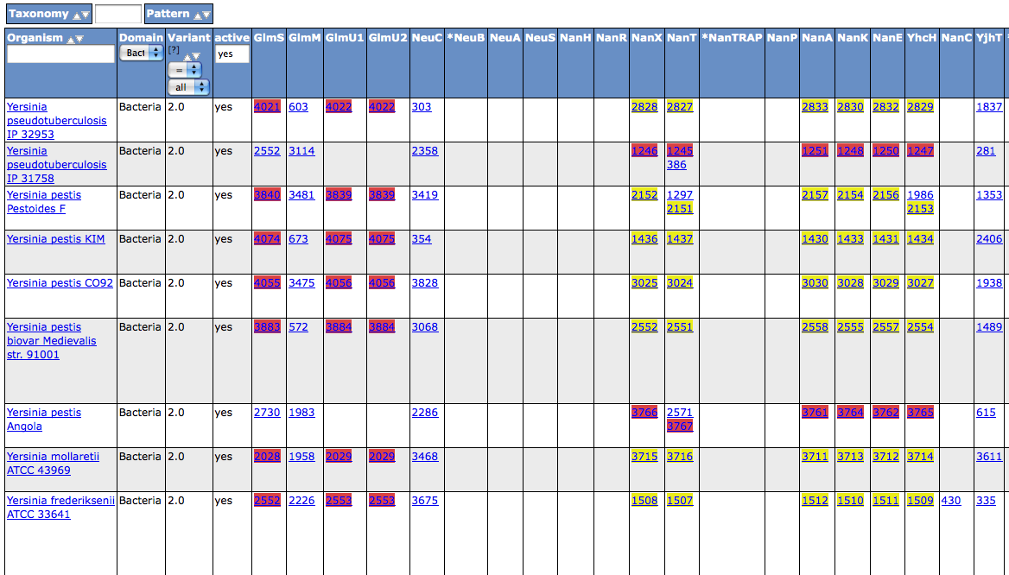
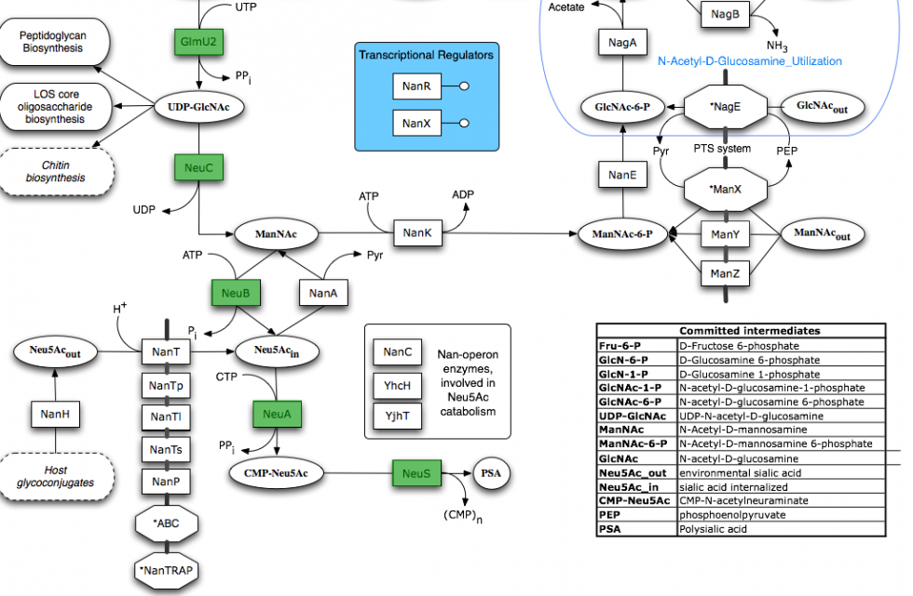
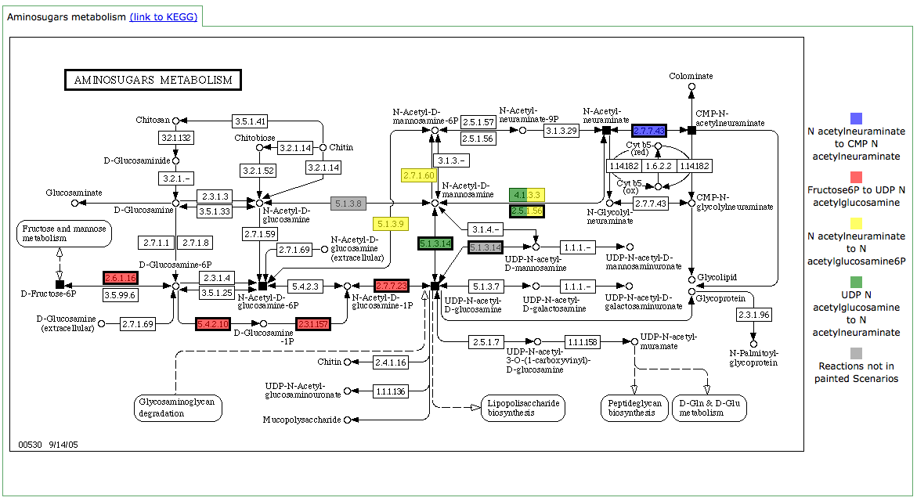
RAST
Annotated Subsystems Diagrams
Comparative and Interactive Spreadsheets
Metabolic “Scenarios”

Slide 21
Model SEED: Converting Annotated Genomes into Genome-scale Metabolic Models
RAST annotation server
Annotated
genome in SEED
Preliminary
reconstruction

Slide 22

Biochemistry Database in the SEED
A biochemistry database was constructed combining content from the KEGG and 13 published genome-scale models into a non-redundant set of compounds and reactions
(8000 rxn)
Acetinobacter: iAbaylyiv4 (874 rxn)
M. barkeri: iAF692 (620 rxn)
B. subtilis: iAG612 (598 rxn)
M. genitalium: iPS189 (263 rxn)
B. subtilis: iYO844 (1020 rxn)
M. tuberculosis: iNJ661 (975 rxn)
E. coli: iAF1260 (2078 rxn)
Combined SEED Database
(12,103 rxn)
P. putida: iJN746 (949 rxn)
E. coli: iJR904 (932 rxn)
H. pylori: iIT341 (476 rxn)
S. aureus: iSB619 (649 rxn)
L. lactis: iAO358 (619 rxn)
S. cerevisiae: iND750 (1149 rxn)
Reactions were then mapped to the functional roles in the SEED based on EC number, substrate names, and enzyme names:
REACTION
COMPLEX
FUNCTIONAL ROLE
GENE
NAD(P) transhydrogenase subunit beta (EC 1.6.1.2)
peg.100
NAD⁺ + NADPH ←→ NADH + NADP⁺
Gene complex
NAD(P) transhydrogenase alpha subunit (EC 1.6.1.2)
peg.101
www.theseed.org/models/

Slide 23
Biomass Objective Function
To test growth of the model, we build a biomass objective function template
Nutrients
ATP+H2O→ADP+Pi
Universal
Energy
dATP, dGTP, dCTP, dTTP
Universal
DNA
Universal
ATP, GTP, CTP, UTP
RNA
Amino acids
Universal
Protein
Cofactors and ions
Depends on genome
Misc
Various acylglycerols
Depends on genome
Lipids
Peptioglycan
Any genome with cell wall
Cell wall
Biomass
Teichoic acid
Gram positive
Cell wall
Core lipid A
Gram negative
Cell wall
Each biomass component may be rejected from the biomass reaction of a model based on the following criteria:
  Subsystem representation
  Functional role presence
  Taxonomy
  Cell wall types
www.theseed.org/models/

Slide 24
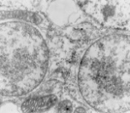
Model SEED: Converting Annotated Genomes into Genome-scale Metabolic Models
Predicted
56 missing
RAST annotation server
metabolic
?
Biomass
?
Annotated
functions/
genome in SEED
model
Preliminary
reconstruction
Predicted
Auto
-
cell
completion
-
host
interactions

Slide 25
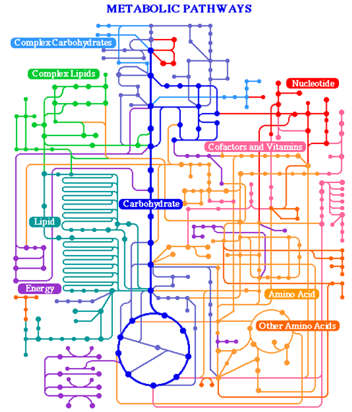
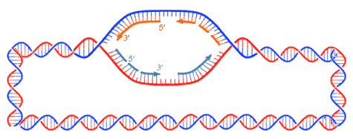
Genome Annotations Contain Knowledge Gaps
flagella
chromosome
transcription factor
?
?
mRNA
?
?
chaperone
protein
ribosome
?
?
metabolic pathways
chemotaxis
transcription
protein folding
transcription
translation
????
????
????
????
www.theseed.org/models/

Slide 26
Flux Balance Analysis
The Cell
C
Nutrient
3
4
Biomass
1
A
?
B
5
D
6
7
V
By product
1
2
3
4
5
6
7
A
B
C
D
www.theseed.org/models/

Slide 27
Model Auto-completion Optimization
Objective:
Penalizing reversibility adjustments
Penalizing addition of reactions to the model
Reactions in model
Reactions not in model
Subject to:
Mass balance constraints:
Compounds in model
N_{core}
N_{db}
v_{core}
0
Compounds not in model
v_{db}
0
N_{db}
Use variable constraints:
Forcing positive growth:
www.theseed.org/models/

Slide 28
Weighting of Reactions in Gapfilling is Important
Not all reactions are weighted equally in the Gapfilling optimization
Many reactions are “blacklisted” prohibiting their use in gapfilling
  Lumped reactions
  Unbalanced reactions
  Reactions with generic species
Thermodynamically unfavorable directions of reactions are penalized
Transport reactions for biomass components are penalized
Addition of reactions that complete existing “subsystems” and “pathways” are reduced in cost
Reactions with unknown structures and thermodynamics are penalized
Reactions not mapped to functional roles in SEED are penalized

Slide 29
Genome Annotation: the Subsystems Approach
flagella
chromosome
transcription factor
?
mRNA
?
chaperone
protein
ribosome
?
metabolic pathways
chemotaxis
transcription
protein folding
transcription
translation
????
????
????
????
www.theseed.org/models/

Slide 30

Model SEED: Converting Annotated Genomes into Genome-scale Metabolic Models
Predicted
130 new metabolic models
56 missing
RAST annotation server
•
?
Biomass
965 reactions
Predicted gene
metabolic
Annotated
•
?
688 genes
essentiality
functions/
genome in SEED
•
876 metabolites
model
Predicted
Preliminary
*
reconstruction
growth media
Predicted
Predicted
Auto
-
cell
completion
-
host
phenotypes
interactions
Model
Analysis
-
accuracy
ready models
66%

Slide 31
Seed Model Statistics
Average: 965
Models contained an average of 965 reactions
  Minimum of 243 reactions (Onion yellows phytoplasma OY-M – 856 genes)
  Maximum of 1529 reactions (Escherichia coli K12 – 4313 genes)
Models contained an average of 688 genes
  Minimum of 193 genes (Onion yellows phytoplasma OY-M – 856 genes)
  Maximum of 1586 genes (Burkholderia xenovorans LB400 – 8748 genes)
www.theseed.org/models/

Slide 32
Seed Models vs Published Models
Single-genome Seed models compare favorably with published single genome models
Organism name | Published model | Published reactions | SEED Reactions | Published genes | SEED genes
Acinetobacter | iAbaylyiv4 | 868 | 1196 | 775 | 785
B. subtilis | iYO844 | 1020 | 1463 | 844 | 1041
C. acetobutylicum | iJL432 | 502 | 989 | 432 | 721
E. coli | iAF1260 | 2013 | 1529 | 1261 | 1083
G. sulfurreducens | iRM588 | 523 | 721 | 588 | 468
H. influenzae | iCS400 | 461 | 969 | 400 | 575
H. pylori | iIT341 | 476 | 731 | 341 | 421
L. plantarum | iBT721 | 643 | 908 | 721 | 699
L. lactis | iAO358 | 621 | 965 | 358 | 646
M. succiniciproducens | iTK425 | 686 | 1048 | 425 | 659
M. tuberculosis | iNJ661 | 939 | 1021 | 661 | 728
M. genitalium | iPS189 | 264 | 294 | 189 | 214
N. meningitidis | iGB555 | 496 | 903 | 555 | 560
P. gingivalis | iVM679 | 679 | 744 | 0* | 399
P. aeruginosa | iMO1056 | 883 | 1386 | 1056 | 1094
P. putida | iNJ746 | 950 | 1261 | 746 | 1053
R. etli | iOR363 | 387 | 1264 | 363 | 1242
S. aureus | iSB619 | 641 | 1115 | 619 | 770
S. coelicolor | iIB700 | 700 | 1159 | 700 | 987
www.theseed.org/models/

Slide 33
Assessing Subsystem Annotations From Auto-completion
We identify how complete the annotations are for each of the Seed subsystems by calculating the following ratio:
auto-completion reactions in subsystem
=
Fraction of subsystem reactions with missing genes
total reactions in subsystem
Highest scoring subsystems:
Cell Wall and Capsule Biosynthesis (15%)
  21 reactions per model added during auto-completion
  LOS Core Oligosaccharide Biosynthesis (Gram negative)
  Teichoic and Lipoteichoic Acids Biosynthesis (Gram positive)
  KDO2-Lipid A Biosynthesis
Cofactors, Vitamins, and Prosthetic Group Biosynthesis (5%)
  10 reaction per model added during auto-completion
  Ubiquinone Biosynthesis
  Menaquinone and Phylloquinone Biosynthesis
  Thiamin Biosynthesis
Six subsystems account for 31/56 reactions added to each model during the auto-completion process
www.theseed.org/models/

Slide 34
Model statistics across the phylogenetic tree
www.theseed.org/models/

Slide 35
Reaction Activity Across All Models
www.theseed.org/models/

Slide 36
Essential Genes Across All Models
www.theseed.org/models/

Slide 37
Essential Nutrients Across All Models
www.theseed.org/models/

Slide 38
Accuracy Before Optimization
Biolog phenotype data
SEED models were used to predict the output of 14 biolog phenotyping arrays
Average accuracy: 60%
Biolog prediction accuracy
Essentiality data
SEED models were used to predict essential genes for 14 experimental gene essentiality datasets
Average accuracy: 72%
Overall accuracy: 66%
Essentiality prediction accuracy
www.theseed.org/models/

Slide 39
Model SEED: Converting Annotated Genomes into Genome-scale Metabolic Models
Predicted
130 new metabolic models
56 missing
RAST annotation server
•
?
Biomass
965 reactions
Predicted gene
metabolic
Annotated
•
?
688 genes
essentiality
functions/
genome in SEED
•
876 metabolites
model
Predicted
Preliminary
*
reconstruction
growth media
Predicted
Predicted
Auto
-
cell
completion
-
host
phenotypes
interactions
Model
Analysis
-
accuracy
ready models
66%
Predicting 69 missing
Biolog consistency
transporters/model
analysis
71%

Slide 40
Biolog Consistency Analysis
Biolog phenotype data
Add transporters for Biolog nutrients if missing from models
69 transporters added to each model on average
Average accuracy: 70%
Biolog prediction accuracy
Essentiality data
Essentiality prediction accuracy
Accuracy unchanged: 72%
Overall accuracy: 71%
www.theseed.org/models/

Slide 41
Model SEED: Converting Annotated Genomes into Genome-scale Metabolic Models
Predicted
130 new metabolic models
56 missing
RAST annotation server
•
?
Biomass
965 reactions
Predicted gene
metabolic
Annotated
•
?
688 genes
essentiality
functions/
genome in SEED
•
876 metabolites
model
Predicted
Preliminary
*
reconstruction
growth media
Predicted
Predicted
Auto
-
cell
completion
-
host
phenotypes
interactions
Model
Analysis
-
Correction for 202 annotations
accuracy
ready models
66%
inconsistent with essentiality data
Predicting 69 missing
Biolog consistency
Essential
Essential
Nonessential
transporters/model
analysis
gene A
gene B
gene C
71%
Gene essentiality
consistency analysis
Corrected
Original
74%
GPR
GPR
Reaction

Slide 42
Annotation Consistency Analysis
Essentiality data
Reconciling annotation inconsistent with essentiality data
Biolog prediction accuracy
Essential gene
A → B
Nonessential gene
Essential gene A
A → B
Essential gene B
Essentiality prediction accuracy
Accuracy 78%
Biolog phenotype data
Accuracy unchanged: 70%
Overall accuracy: 75%
www.theseed.org/models/

Slide 43
Model SEED: Converting Annotated Genomes into Genome-scale Metabolic Models
Predicted
130 new metabolic models
56 missing
RAST annotation server
•
?
Biomass
965 reactions
Predicted gene
metabolic
Annotated
•
?
688 genes
essentiality
functions/
genome in SEED
•
876 metabolites
model
Predicted
Preliminary
*
reconstruction
growth media
Predicted
Predicted
Auto
-
cell
completion
-
host
phenotypes
interactions
Model
Analysis
-
Correction for 202 annotations
accuracy
ready models
66%
inconsistent with essentiality data
Predicting 69 missing
Biolog consistency
Essential
Essential
Nonessential
transporters/model
analysis
gene A
gene B
gene C
71%
Gene essentiality
consistency analysis
Corrected
Original
74%
GPR
Model opt:
GapFill
GPR
82%
Reaction
Correcting
A
B
Predicted
reversibility
A
B
missing and
constraints
extra metabolic
?
Biomass
A
B
?
functions

Slide 44
Model Optimization: Gap Filling
Additional gap filling:
In vivo
No growth
Growth
Biolog prediction accuracy
No growth
In silico
Growth
Fix false negative predictions by adding reactions to models
Essentiality prediction accuracy
Biolog accuracy
Average accuracy: 83%
Essentiality accuracy
Average accuracy: 81%
Overall accuracy: 82%
www.theseed.org/models/

Slide 45
Model SEED: Converting Annotated Genomes into Genome-scale Metabolic Models
Predicted
130 new metabolic models
56 missing
RAST annotation server
•
?
Biomass
965 reactions
Predicted gene
metabolic
Annotated
•
?
688 genes
essentiality
functions/
genome in SEED
•
876 metabolites
model
Predicted
Preliminary
*
reconstruction
growth media
Predicted
Predicted
Auto
-
cell
completion
-
host
phenotypes
interactions
Model
Analysis
-
Correction for 202 annotations
accuracy
ready models
66%
inconsistent with essentiality data
Predicting 69 missing
Biolog consistency
Essential
Essential
Nonessential
transporters/model
analysis
gene A
gene B
gene C
71%
Gene essentiality
consistency analysis
Corrected
Original
74%
GPR
Model opt:
GapFill
GPR
82%
Model opt:
GapGen
Reaction
A
B
87%
Correcting
Predicted
reversibility
A
B
missing and
constraints
extra metabolic
?
Biomass
A
B
?
functions

Slide 46
Model Optimization: Gap Generation
Additional gap filling:
In vivo
No growth
Growth
Biolog prediction accuracy
No growth
In silico
Growth
Fix false positive predictions by removing reactions from models
Essentiality prediction accuracy
Biolog accuracy
Average accuracy: 88%
Essentiality accuracy
Average accuracy: 85%
Overall accuracy: 87%
www.theseed.org/models/

Slide 47
Model SEED: Converting Annotated Genomes into Genome-scale Metabolic Models
Predicted
130 new metabolic models
56 missing
RAST annotation server
•
?
Biomass
965 reactions
Predicted gene
metabolic
Annotated
•
?
688 genes
essentiality
functions/
genome in SEED
•
876 metabolites
model
Predicted
Preliminary
*
reconstruction
growth media
Predicted
Predicted
Auto
-
cell
completion
-
host
phenotypes
interactions
Model
Analysis
-
Correction for 202 annotations
accuracy
ready models
66%
inconsistent with essentiality data
Predicting 69 missing
Biolog consistency
Essential
Essential
Nonessential
transporters/model
analysis
gene A
gene B
gene C
71%
Gene essentiality
consistency analysis
Corrected
Original
74%
GPR
Model opt:
GapFill
GPR
82%
Model opt:
GapGen
Reaction
A
B
87%
Correcting
Optimized
Predicted
reversibility
A
B
models
missing and
constraints
extra metabolic
?
Biomass
A
B
22 optimized models
?
functions

Slide 48
Words of Caution in Automated Model Construction and Use
1.) Automatically constructed models are drafts, not complete products
2.) Automatically built models are less useful for quantitative predictions without fitting to experimental data, but good for identifying annotation errors and predicting growth conditions
3.) Curation is required to “complete” these models:
-Extra reactions may be present that must be trimmed due to overly generic annotations, and reactions may be missing due to overly specific annotations
-Cofactors used in reactions may be incorrect if the true cofactors utilized by an organism are unknown
-Highly distinctive biochemistry performed by an organism may be missing it not well annotated or if biochemical pathways are not included in the Model SEED map
-Biomass reactions will be missing components, and coefficients in biomass reactions must be adjusted based on measured growth rates
www.theseed.org/models/

Slide 49
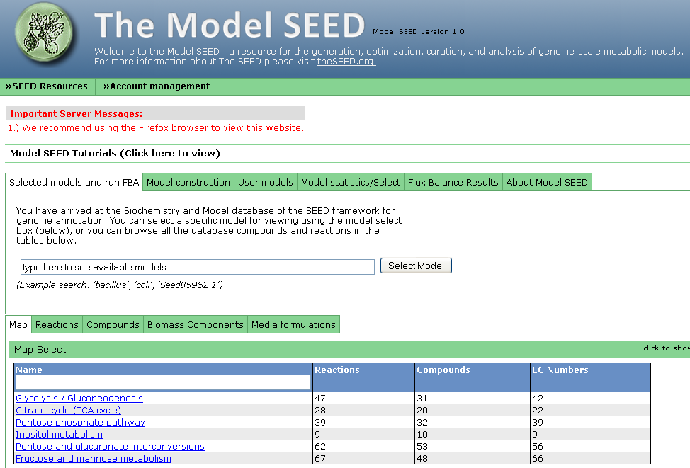
Model SEED Website: www.theseed.org/models/
Notes:
More balloons and explaination… but we won’t linger on repetitive stuff. Maybe a little more on “link to genome page”. What gneome pagE?

Slide 50
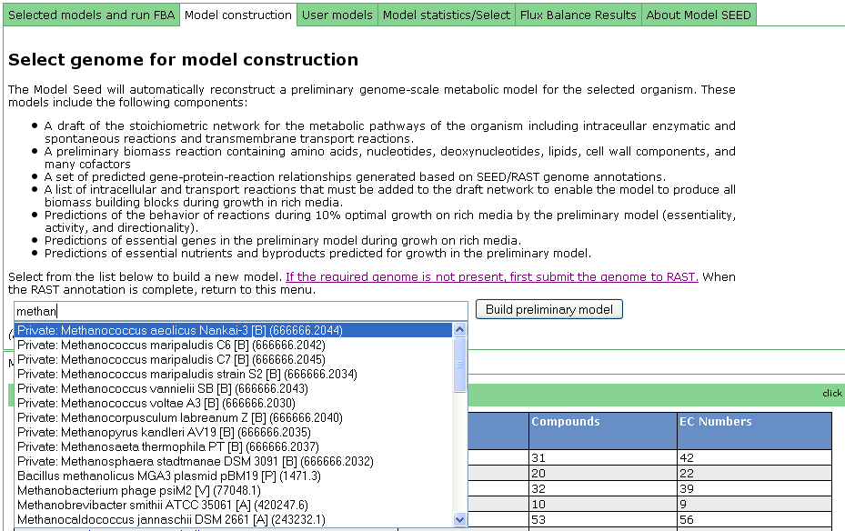
Building Metabolic Models in Model SEED
1.) Build model of an existing SEED or RAST genome from the Model SEED website:
Click on the model construction tab
Type the name of the organism in the select box
Notes:
More balloons and explaination… but we won’t linger on repetitive stuff. Maybe a little more on “link to genome page”. What gneome pagE?

Slide 51
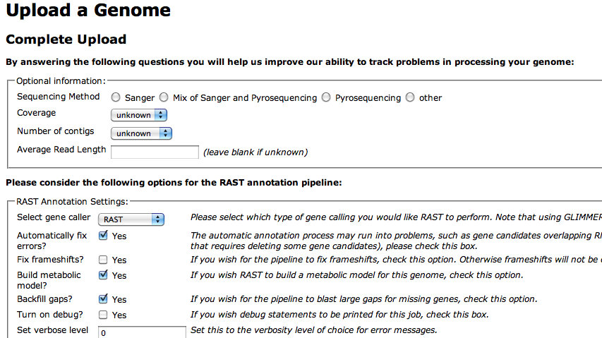
Building Metabolic Models in Model SEED
2.) Order RAST to automatically build a model for a genome as soon as the annotation process completes
Check this box, and your genome will automatically be submitted to Model SEED one annotated

Slide 52
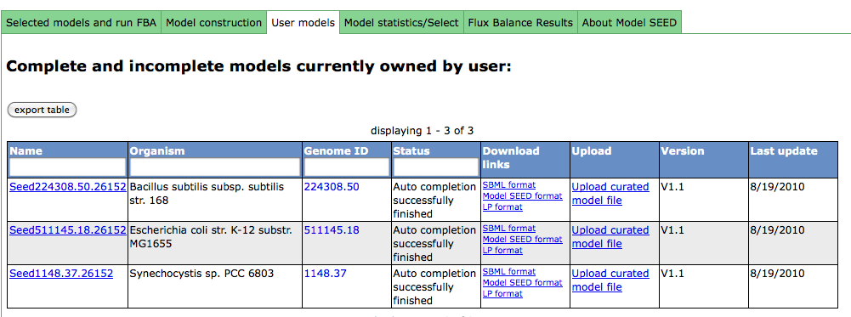
Select User / Private models
select model for viewing
link to genome page
Download formats for models:
-SBML format for use in Cobra Toolkit and OptFlux
-Model SEED tabular format
-LP format for use with optimization software like GLPK or CPLEX
Notes:
Add more labels and balloons indicating that the same info is here. Can we get a screen shot with the upload column active? Just say we’ll explain that feature later

Slide 53
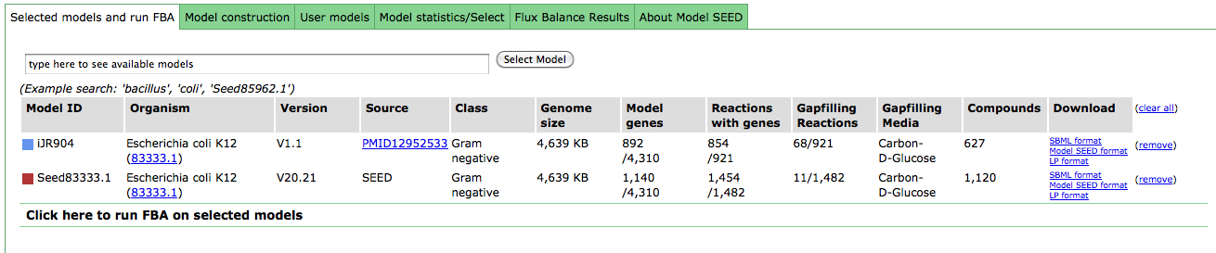
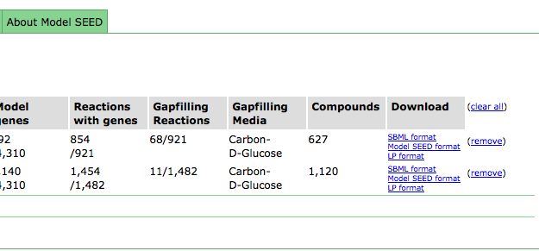
Selecting multiple models for comparison
link to SEED genome annotation page
download model
remove from page
Notes:
More balloons and explaination… but we won’t linger on repetitive stuff. Maybe a little more on “link to genome page”. What gneome pagE?

Slide 54
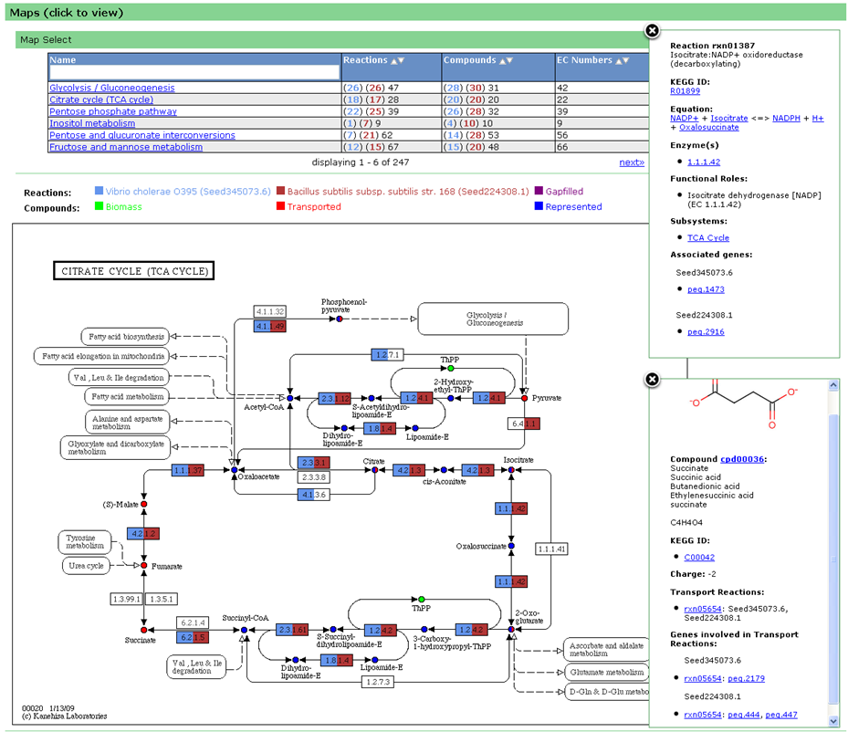
KEGG Map details on multiple models
Models are painted onto KEGG maps with multiple colors signifying different models
(# in Model 1) (# in model 2)
total on map for both reactions and compounds
Click map names to bring map up in a tab
Click on reactions and compounds to view additional data and links
www.theseed.org/models/

Slide 55
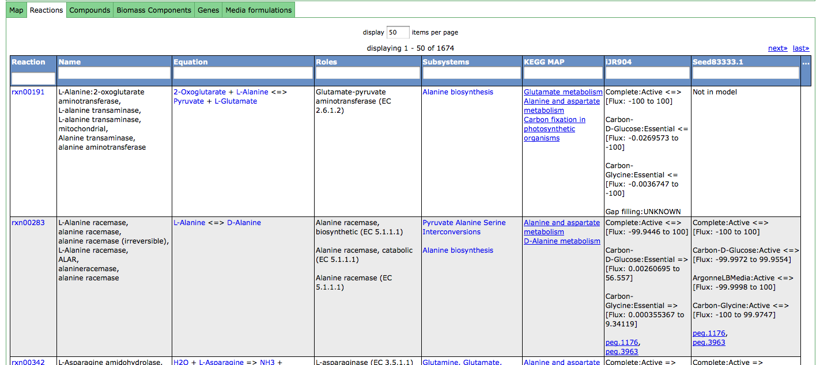
Compare model reactions
View reaction details; search and sort by reaction details.
Compare reaction predictions for two models
Additional columns available under dropdown menu.
Notes:
Perhaps explain predictions a little more. Media:behavior

Slide 56
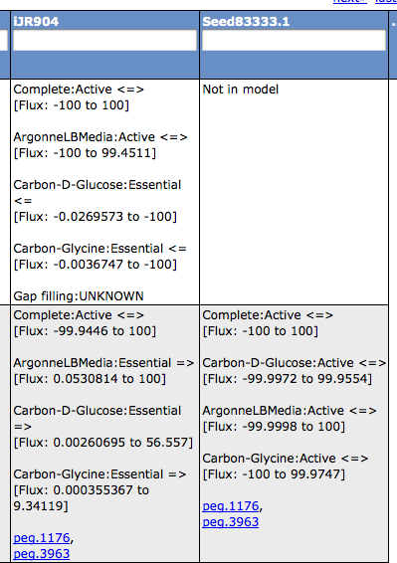
Compare model reactions: looking at predictions
Predictions for reaction activity under various media conditions. Can be:
Active, Essential or Inactive.
Reaction directionality “=>” forward,
“<=“ backward and “<=>” reversible
Reaction added to model via gapfilling or based on a set of genes that enable the reaction.

Slide 57
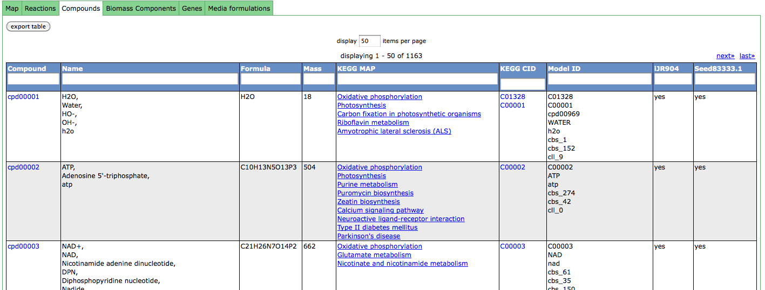
Compare compounds present in model
Click header to sort table by column.
Compound table shows whether compound is included in model
Notes:
Possible look for more interesting compounds to display.

Slide 58
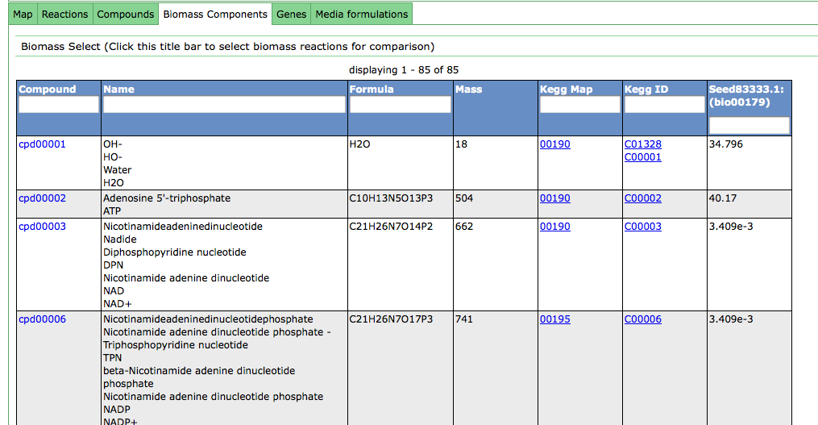
Compare biomass objective functions of each model
Select additional biomass
reactions
This is mmol consumed per gram biomass produced
Notes:
Explain coefficients (mmol consumed/gram biomass produced)

Slide 59
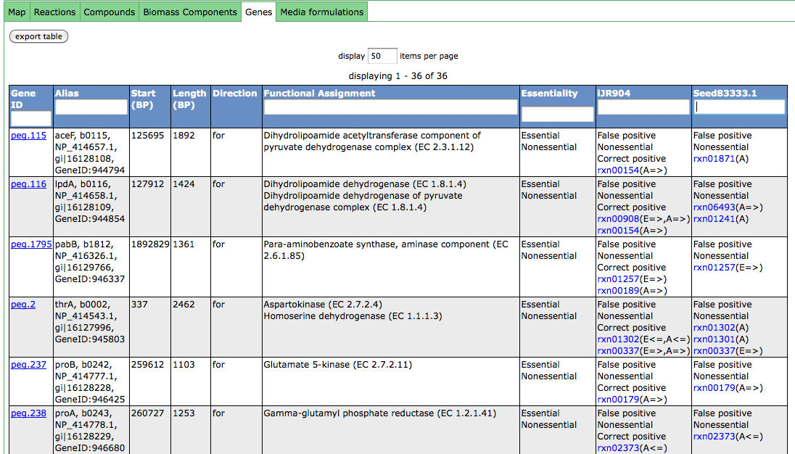
Compare gene essentiality in models
Model annotation of genes:
“A” is active, “E” is essential and
“I” is inactive. “=>” is forward,
“<=“ is reverse and “<=>” is both.
Multiple annotations for different media conditions: hover over “A=>” for media condition name.
Currently only works when compared models use the same genome.
Notes:
Lots more explaination. A means active. I means inactive. Highlight the “I”. “E” means essential. And “=>” means direction, and is only listed if the reaction is active in only a single direction. Explain hovers. Hovering a reaction gives you a gene list. Hovering “A”, I,E gives you the media. Redo screen shot. Show screen with false positive or false negative on a model.

Slide 60
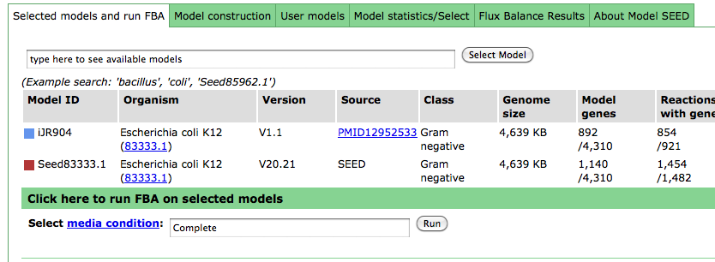
Run flux balance analysis on models
Click on green “blind” to open FBA panel.
Begin typing media name to select, then click “Run”.
Notes:
Make sure we cover rollerblind for FBA

Slide 61
Future Development Plans
We are actively working on converting the Model SEED into an interactive environment for the curation of metabolic models
We are continuing to integrate published metabolic models and biochemical databases (e.g. BioCyc) into the Model SEED mappings to improve gapfilling and coverage of distinctive biochemistry
We are enabling the upload of experimentally gathered phenotype data for model validation by users
We are working on enabling the export and import of PGDB models into the Model SEED
We are also enabling users to upload their own models, create their own reactions/compounds/media formulations, and run a variety of FBA algorithms
www.theseed.org/models/

Slide 62



Acknowledgements
ANL/U. Chicago Team
Robert Olson
Terry Disz
Daniela Bartels
Tobias Paczian
Daniel Paarmann
Scott Devoid
Andreas Wilke
Bill Mihalo
Elizabeth Glass
Folker Meyer
Jared Wilkening
Rick Stevens
Alex Rodriguez
Mark D’Souza
Rob Edwards
Christopher Henry
FIG Team
Ross Overbeek
Gordon Pusch
Bruce Parello
Veronika Vonstein
Andrei Ostermann
Olga Vassieva
Olga Zagnitzko
Svetlana Gerdes
Hope College Team
Aaron Best
Matt DeJongh
Nathan Tintle
Hope college students

