Slide 1
Genome-wide association studies for microbial genomes
Bas E. Dutilh
March 4th 2013

Slide 2
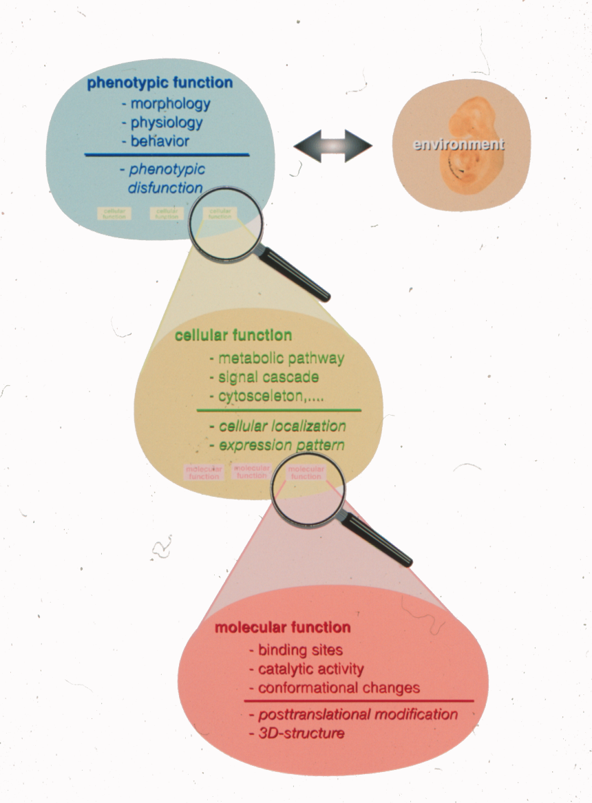
Protein function
Phenotypic function
E.g. apoptosis
GO: Biological process
Cellular function
E.g. ribosome
GO: Cellular component
Molecular function
E.g. transcription factor
GO: Molecular function
GO Consortium Genome Res. 2001
Bork et al. J. Mol. Biol. 1998

Slide 3
Molecular function ↔ phenotype
Molecular systems biology
First determine protein functions
… then model how functions lead to phenotype
Comparative genomics
First sequence a set of genomes with different phenotypes
… then link genes to phenotype

Slide 4
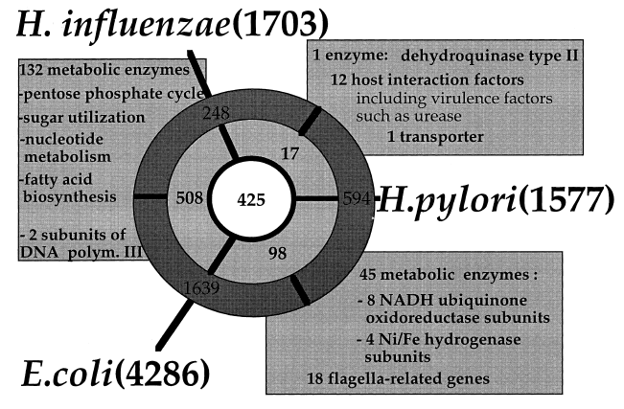
1998: differential genome analysis
Virulence factors
De-acidifiers
Huynen et al. FEBS Lett. 1998

Slide 5
2013: microbial GWAS
210 Vibrio cholerae genomes
3 niche dimensions
Time
Space
Habitat
24,000+ variables
Protein families
Functions
Prophages
SNPs
Large p small n
Risk of over-training many genotypes to few samples
Dutilh et al. in preparation

Slide 6
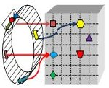
Pre-processing
Genotypes
Highly correlating genotypes
E.g. genes in one operon
Delete monotonous features
E.g. housekeeping genes
Phenotypes
Discard ambiguous phenotypes (noise)
E.g. growth: Yes / No / Partial / Unknown
Decrease class imbalance by bagging
Largest class ≤ 2x smallest class
PhenoLink
Bayjanov et al. BMC Genomics 2012

Slide 7
Random Forest
Training
Testing
V4
V4
V2
V2

Slide 8
Importance score
Space (continent)
Phage packaging machinery
Bacteriophage P4 cluster
R1t-like Streptococcal phages
Phage family Inoviridae
Integrons
CBSS.350688.3.peg.1509
Potassium homeostasis
Phenazine biosynthesis
Cyanophage
Outer membrane proteins
Importance →

Slide 9
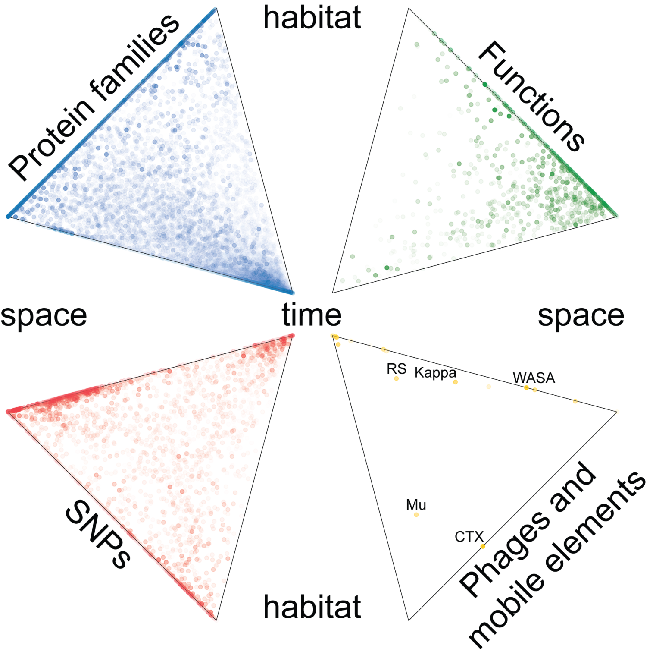

Slide 10
From statistics to biology
GO terms enrichment
Visualization
Metabolic map
STRING database
Franceschini et al. Nucl. Acids Res. 2013

Slide 11
Bottlenecks for microbial GWAS?
Genome sequencing and annotation
SNPs: mutations or indels
Presence/absence of orthologs (gene content)
Phages
Phenotypes measured consistently
Standard phenotype microarray
Specialized phenotype microarray (e.g. for species) to bring out differences (e.g. between strains)
Make these data available
Central database
Dutilh et al. Brief. Funct. Genomics 2013

Slide 12
Transcriptome-trait mapping in L. plantarum
± NaCl
Amino acids
Temperature
pH
Oxic / anoxic
van Bokhorst-van de Veen et al. PLoS ONE 2012

Slide 13
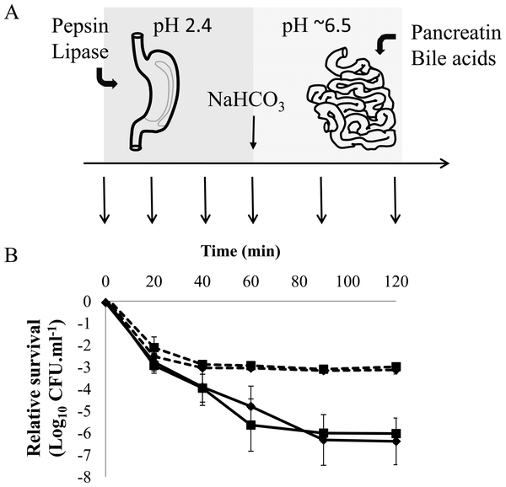
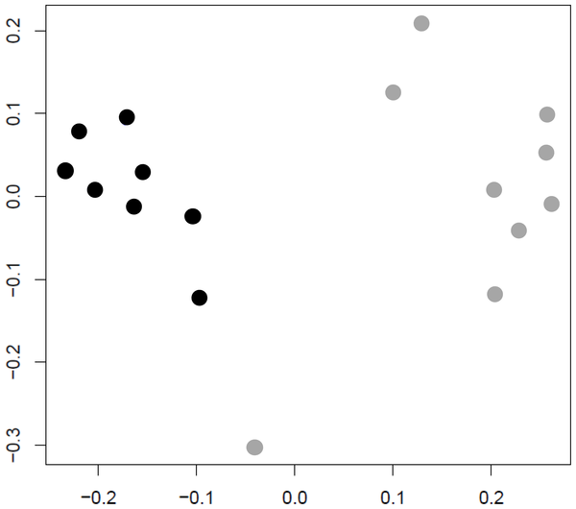
Survival in simulated GI tract
Good survivors
Bad survivors
van Bokhorst-van de Veen et al. PLoS ONE 2012

Slide 14
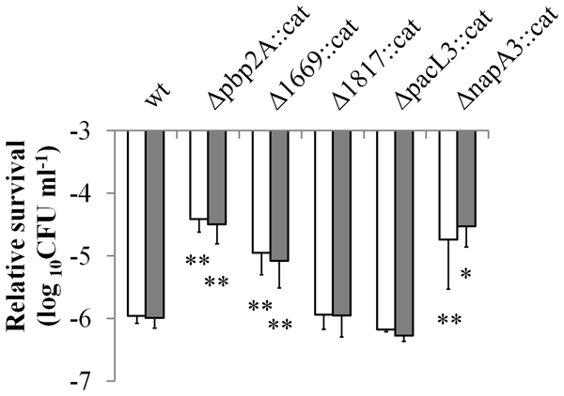
Genes whose expression predicts survival
Positive
correlation with survival
Negative correlation with
survival
van Bokhorst-van de Veen et al. PLoS ONE 2012

Slide 15
Conclusions
The many (draft) genomes can be exploited for linking phenotype to genotype on a genomic scale
Consistently measured phenotypes across a series of sequenced strains are still rare
Phenotype microarrays should be measured for every sequenced genome (cultured)
Central repository for PM data is needed
Transcriptome-trait mapping within one species
Metagenome-trait mapping for communities

Slide 16
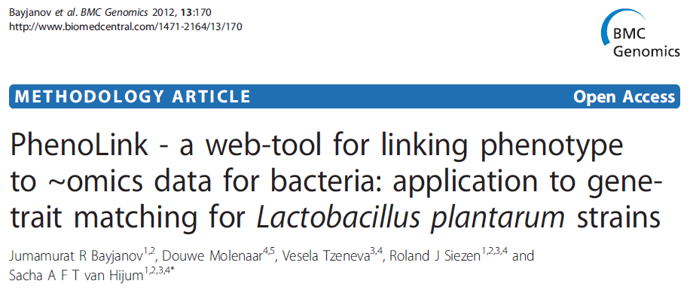
Thank you

