Slide 1
Functional Annotation of Formerly “Unculturable” SAR11 Bacteria
Jim Tripp, JGI
Stanford Research Institute
March 4, 2013

Slide 2
Overview
SAR11 biomass equals that of fish
SAR11 cultured poorly in natural seawater only
Genome revealed major surprises
  No ability to reduce sulfur
  Some strains non-glycolytic; gluconeogenic only
  Serine made from glycine, not reverse
  Glycine riboswitch controls central carbon flow
SAR11 can now be cultured in artificial seawater
  Maximum cell density improved by 100X
  New effects observable

Slide 3
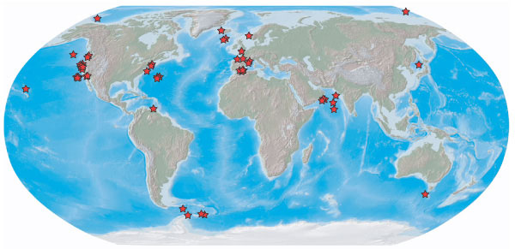
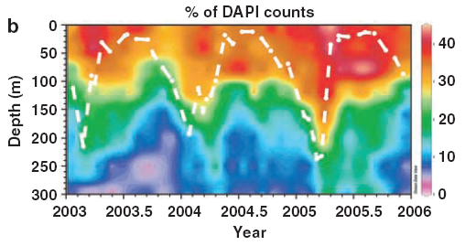
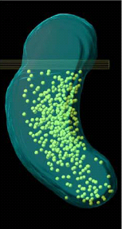
SAR11: Ubiquitous, Abundant, Tiny
Morris et al. 2002
100 nm
Nicastro, 2006
Carlson et al. 2009

Slide 4
SAR11 Isolation: Natural Medium
Oligotrophic seawater plus ammonium and phosphate.
Can’t get more cells with “typical” added nutrient sources.
Biomass for genome sequencing can be obtains from large scale culturing in 20 L carboys.
Rappé et al., Nature 2002

Slide 5
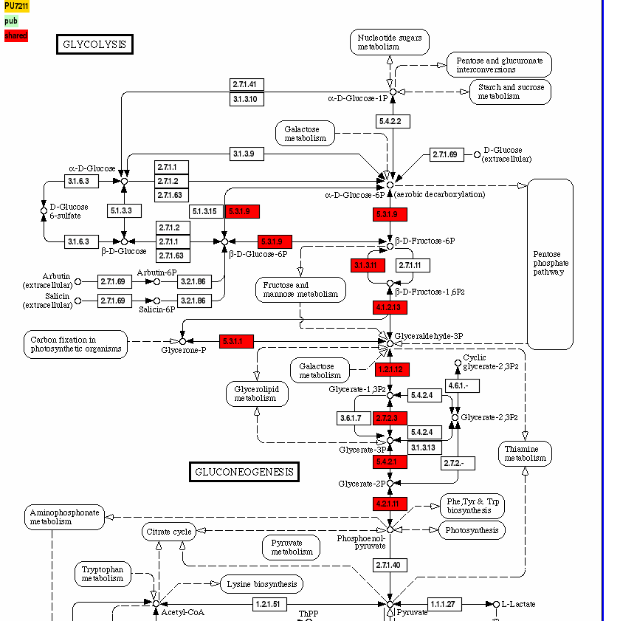
Common Embden-Meyerhoff-Parnas Deficiencies in SAR11
Step 1: PTS Import Missing
Step 3: 6-phosphofructokinase
Step 10: pyruvate kinase

Slide 6
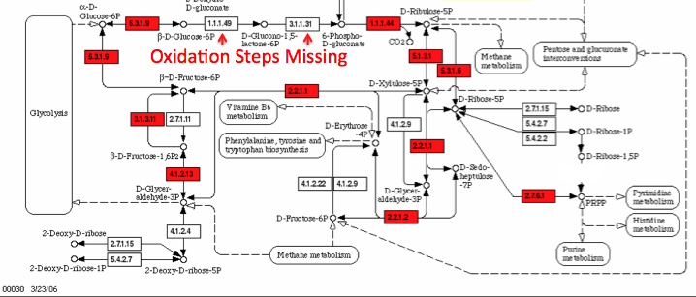
No Oxidative Portion of Pentose P Path
Perhaps run non-oxidative portion backwards from gluconeogenesis.

Slide 7
Putative Entner Doudoroff Path, Some SAR11
Putative glucose metabolism operon
1062
gabD
fabG
ROK
ABC sugar transp.
gdh
edd
gdh
FAA
gnl
gnd
FAA
1002
gabD
fabG
ROK
ABC sugar transp.
gdh
edd
gdh
FAA
gnl
gnd
FAA
7211
1kbp
gabD
FAA
ROK = repressor, ORF, kinase FAA = fumarylacetoacetate hydrolase
gdh = glucose dehydrogenase gnl = gluconolactonase
edd = 6-phosphogluconate dehydratase gnd = 6-phosphogluconate dehydrogenase
gabD = succinate-semialdehyde dehyrog. fabG = short chain fatty acid dehydrogenase

Slide 8
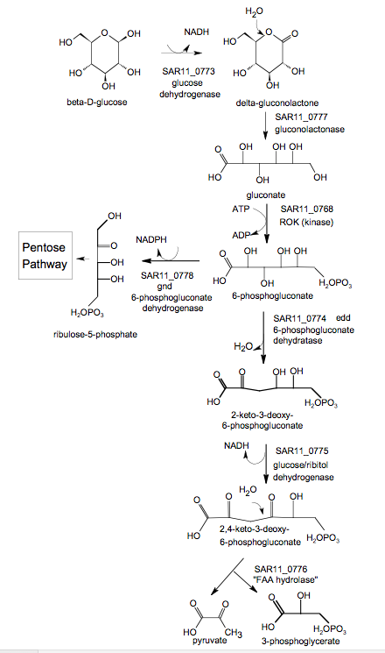
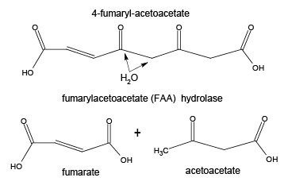
Novel Step in Entner Doudoroff Path
Putative glucose metabolism operon
ROK
ABC sugar transp.
gdh
edd
gdh
FAA
gnl
gnd
Speculative reconstruction

Slide 9
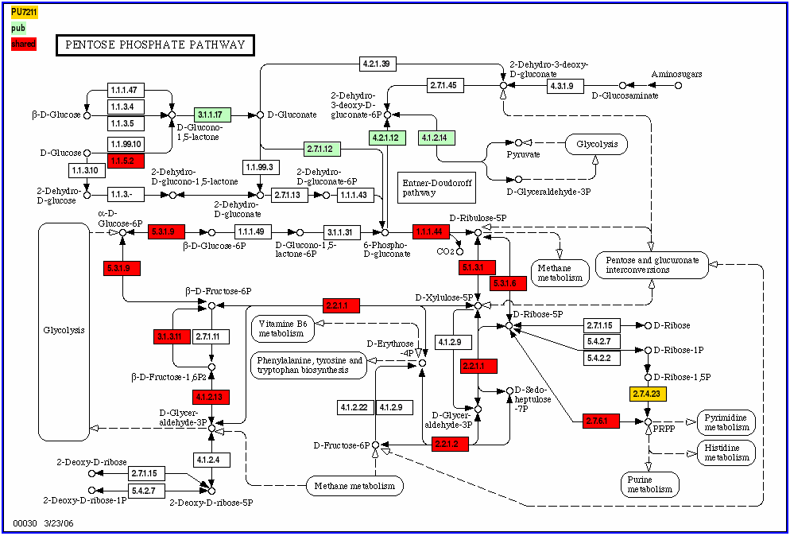
Possible Novel Entner-Doudoroff in Some Not All SAR11 Strains
Enzymes in green provided by putative glycolytic operon
? FAA
? ROK
Glycerate-3P?
Oxidation Steps Missing
Notes:
Gold is PU7211 only. Green is 1062 only. Red is shared (see upper left).

Slide 10
No Serine from 3-PGA: Methyl Consumer
glucose
NORMAL
methyls
betaine
glycine
serine
3-PGA
2C
3C
methyls
SAR11
oxaloacetate

Slide 11
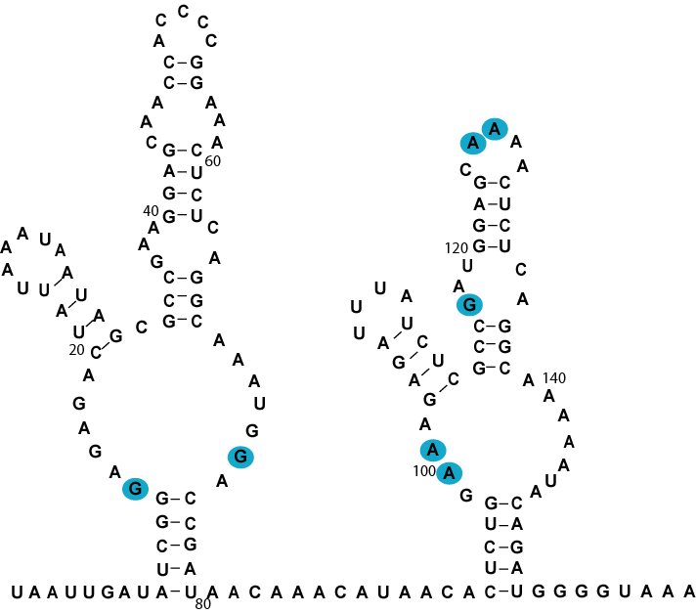
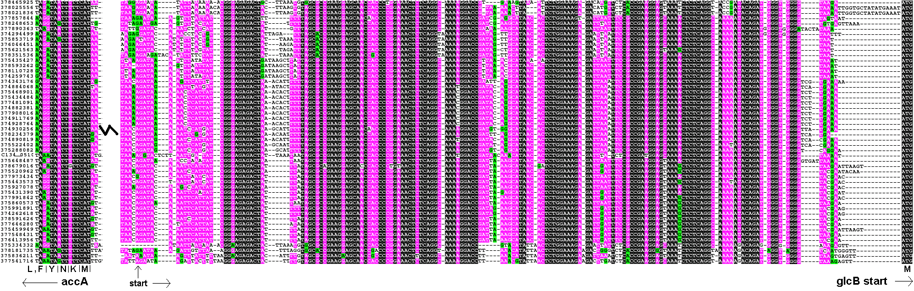
Glycine Riboswitch On Malate Synthase
Malate synthase controls fate of glyoxylate in central carbon metabolism.
metagenomic contigs, GOS

Slide 12
Malate Synthase Role in Central Metabolism
acid
acid
glycolate
glycine
Dual role routing carbon to glycine biosynthesis or biomass accumulation from acids.

Slide 13
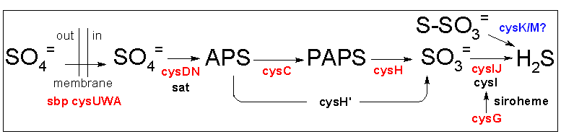
SAR11 Genomics: Sulfur Requirement
Cys
Met
Red = E. coli
Blue = SAR11
Environmental fragments containing assimilatory sulfate reduction genes do not have genes with best hits to SAR11 cultured representative

Slide 14
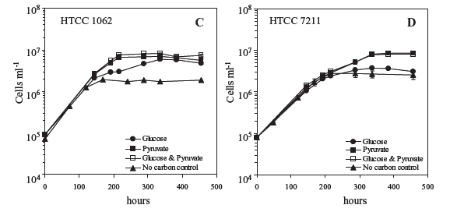
Results: Pyruvate, Glycine, Methionine Give 10X Improvement in Natural Seawater
Coastal Pacific
Open Ocean Atlantic
Old limit
Schwalbach, Tripp et al. 2010

Slide 15
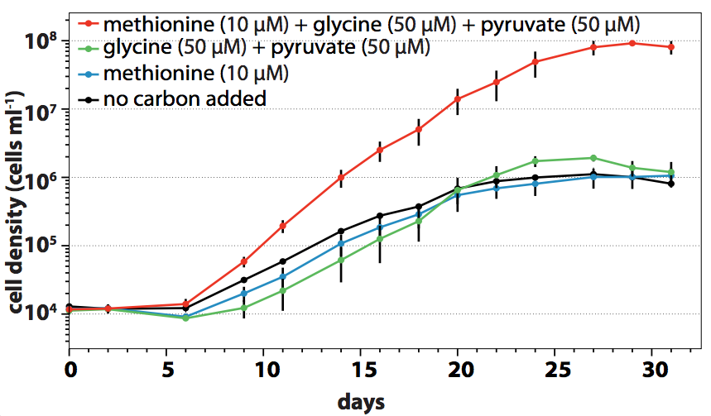
100X Max Density in Artificial Seawater
Carini et al. 2012

Slide 16
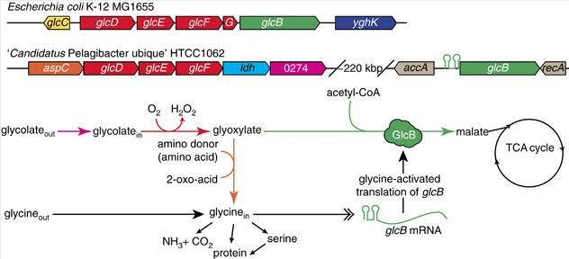
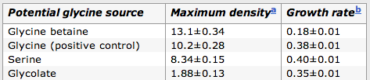
Glycolate Gives Some Glycine
Effect seen only in artificial seawater so far.
Other new effects as well.
Carini et al. 2012

Slide 17
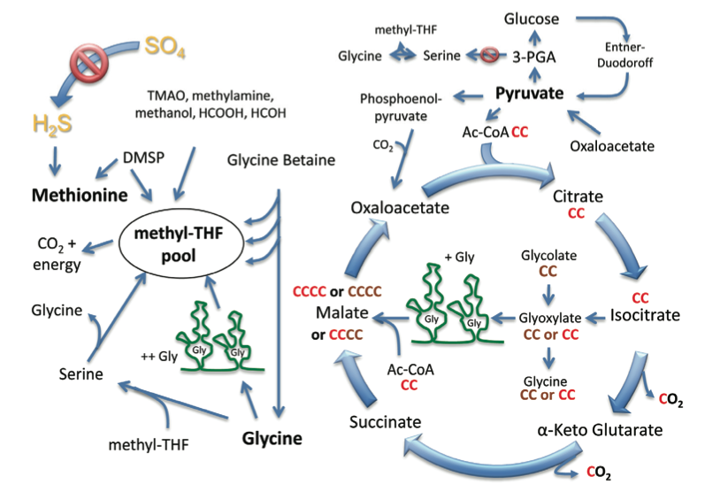
SAR11 Metabolism: Wholistic View
Tripp, review article in press

Slide 18
Still Unanswered
Why is SAR11 strategy so successful?
Why are some phenomena only observable in artificial seawater?
What is it in rich media that inhibits growth?

Slide 19
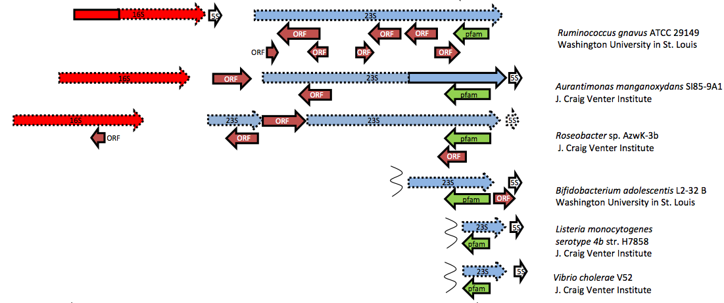
Postscript: Improve Annotation
rRNA misannotation as protein so widespread that pfam started a family: pfam now maintains “Anti-fam”

Slide 20
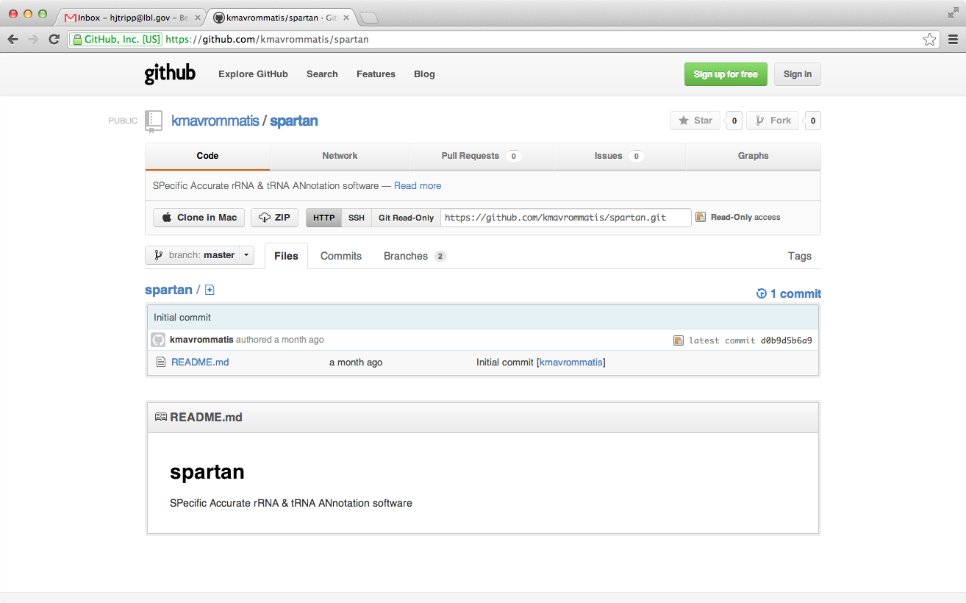
Beta Test, rRNA Finder SPARTAN

Slide 21
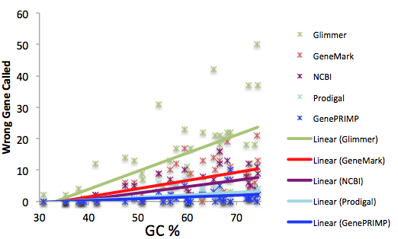
Proteogenomic Comparison of ab initio Gene Callers
Preliminary, meeting in progress (today!)

Slide 22
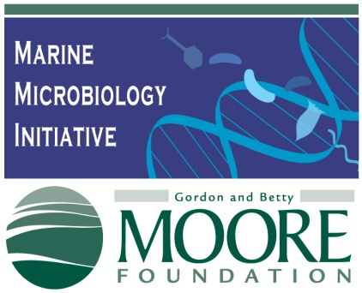

Acknowledgements
Giovannoni Lab, Oregon State
Mike Schwalbach, Joshua Kitner, Larry Wilhelm, Paul Carini
Joint Genome Institute
Amrita Pati, Natalia Ivanova, Kostas Mavrommatis, Nikos Kyrpides
Breaker Lab, Yale University
Ronald Breaker, Michelle Meyer

