Slide 1
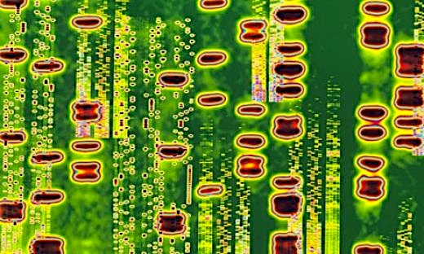
Analysis of environmental genomes using Pathway Tools
Steven Hallam | University of British Columbia
SRI International, 2013

Slide 2
Overview
Through the looking glass…
Environmental Pathway/Genome Databases
MetaPathways Pipeline Development

Slide 3
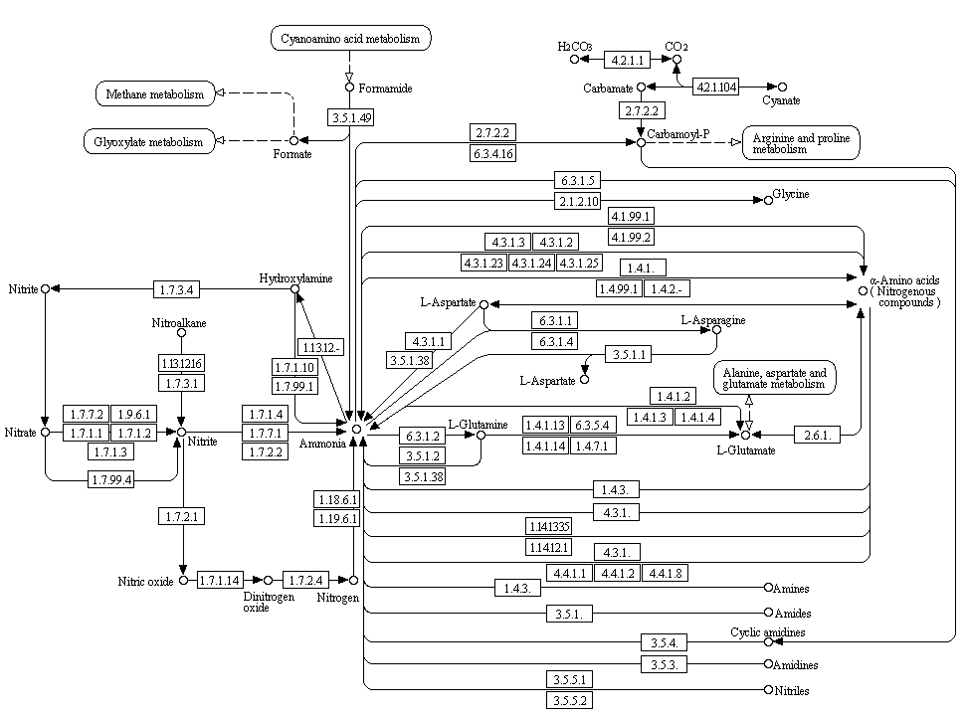
Metabolism
Vertex = chemical [substrate, product]
Edge = enzyme
  Metabolism, or the synthesis and decomposition of chemicals in a cell can be organized into pathways represented by graphs.

Slide 4
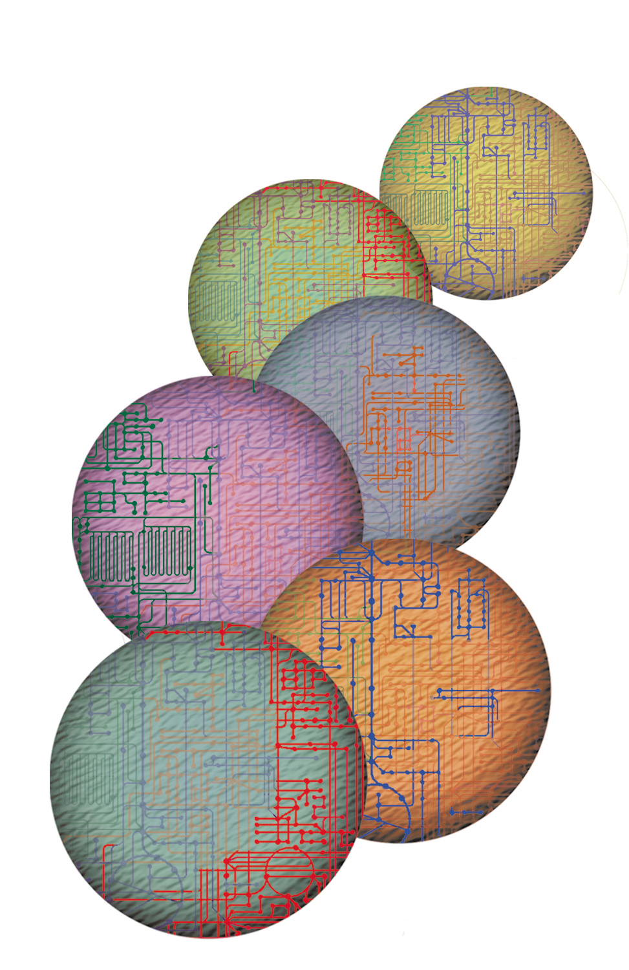
Cellular Pathways
Genome Management Information System, Oak Ridge National Laboratory
  Our genetic and biochemical understanding of metabolism is based largely on the study of complete pathways within cells.

Slide 5
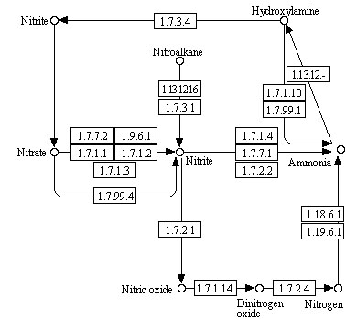
Distributed Pathways
  However, microbial communities form distributed metabolic pathways directing matter and energy exchange.

Slide 6
Community Metabolism
  The goal is to predict and compare distributed pathways to better understand biogeochemical cycling and community metabolism in the environment.

Slide 7
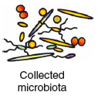
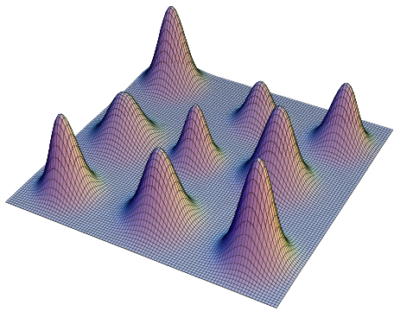
Predicting Community Metabolism
Plurality Sequencing
Single-Cell Sequencing
Fragment Recruitment, SOM, PCA
Environmental PGDB (ePGDB)
with Taxonomic Binning
Simulated
ePGDB

Slide 8
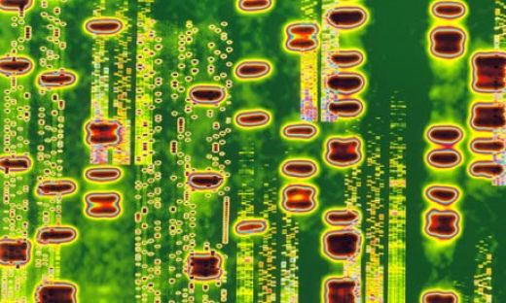
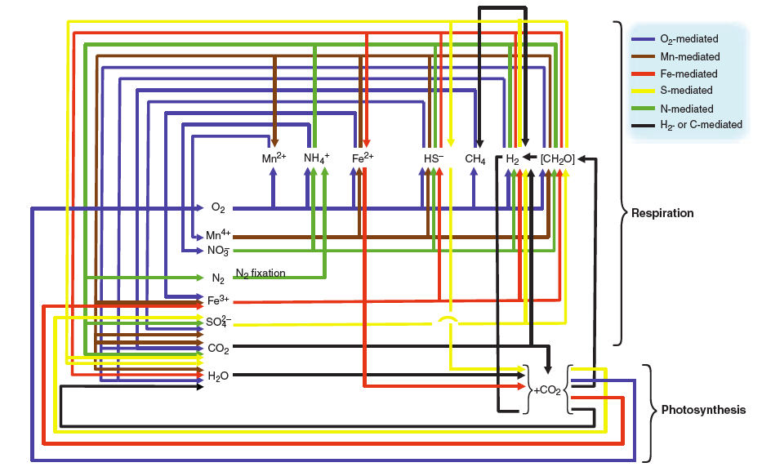
From Genomes to Biomes
Falkowski et al., (2008) Science 320, 1034-1038
Metagenome
Distributed Pathways
Biogeochemical Cycles
“The regulation of the pools and fluxes in biogeochemical cycles have their origins in the genetic inventory of individual microbes, and the regulation of these genes within the organism is determined by the environment. As such, one can look at the microbial food web as a collection of genomes whose expression and replication is coordinated through complex feedback loops at the organismal, population, and ecosystem level. “_{Chisholm}
Notes:
Quoting chisholm, carey NSF draft report, “The regulation of the pools and fluxes in biogeochemical cycles have their origins in the genetic inventory of individual microbes, and the regulation of these genes within the organism is determined by the environment. As such, one can look at the microbial food web as a collection of genomes whose expression and replication is coordinated 3/4 through complex feedback loops 3/4 at the organismal, population, and ecosystem level. As individual microbial genomes are mosaics of genes of mixed heritage, a microbial community is a collection of gene functions distributed amongst its individual members. No single organism contains all the genes necessary to perform the diverse biogeochemical reactions that make up ecological community function. Yet, distributed amongst the community, are all the functions necessary to define that community’s interaction with its environment. One of the novel disciplines that may arise from environmental genomics efforts is “genome ecology”. Conceptually, one can view the collective genomes from a given environment as a single unit, which can be compared directly with that derived from another habitat, or from the same environment at a different time. Is there a defined family of genomes (or genome contents) that defines the biome of a given environment (regardless of species composition)? As sequence sample size increases, does the quantity of genome contents increase proportionally? At what sample size is ‘genome content saturation’ reached for any given habitat? In a related sense, one might model the minimal collective ‘environmental genome’, in analogy to recent efforts to define the minimal genome of a free living microbe. Would this be the definition of the ‘minimum ecological unit’? These are profound questions, which until recently were completely outside our grasp.”

Slide 9
Foundational Questions
What is the taxonomic and functional structure of the ecosystem?
How does this structure change in response to environmental perturbation?
What are the ecological consequences of this change?
What are relevant units of selection, conservation or utilization for ecological genomic resources?

Slide 10
Overview
Through the looking glass…
Environmental Pathway/Genome Databases
MetaPathways Pipeline Development

Slide 11
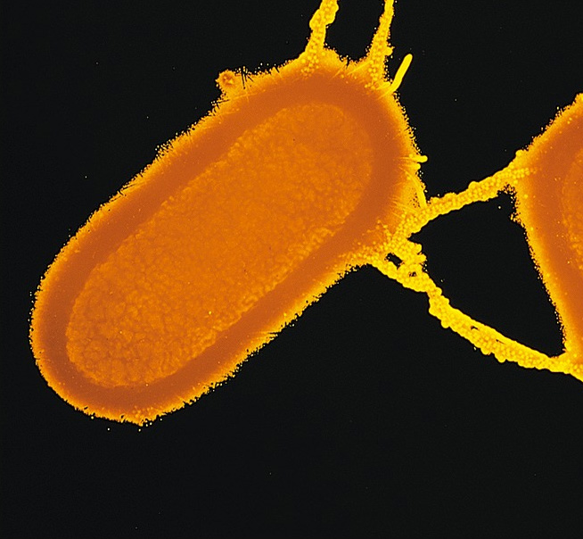
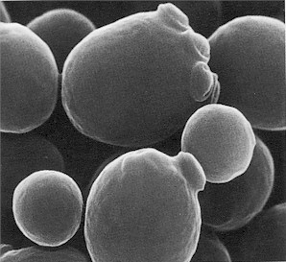
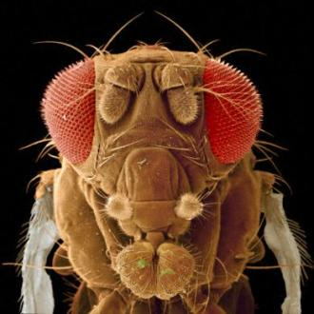
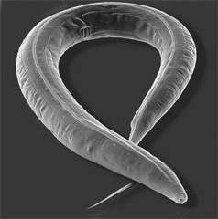


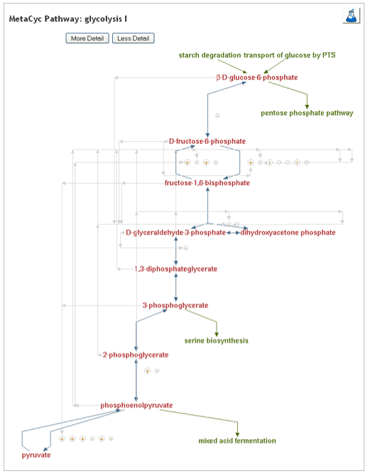
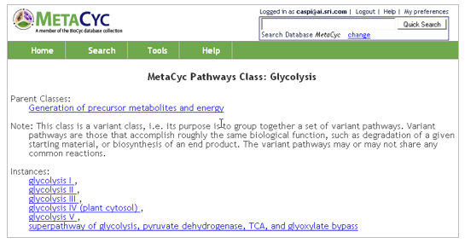
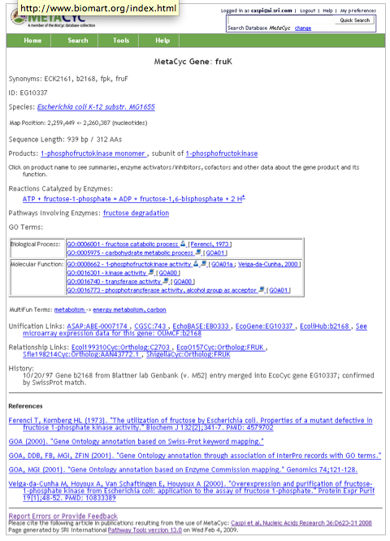
Inference of Metabolic Pathways
Organisms
PGDB Navigator
Genomic Map
Genomic Map
Pathways
Genes/ORFs
Genes/ORFs
Reactions
Gene Products
Gene Products
Compunds
Pathologic*
PGDB
Compounds
Gene Products
Reactions
Genes/ORFs
Pathways
Genomic Map
* Integrates genome and pathway data to identify putative metabolic networks

Slide 12
Pathway/Genome Navigator
Pathway Viewer
Homepage
Evidence Glyph
Metabolite
Enzyme Found
Unique Enzyme
PGDB*
Pathway Information
Gene Information
*http://ecocyc.org/META/new-image?type=PATHWAY&object=GLYCOLYSIS

Slide 13
Environmental PGDB
???
Genomic Map
Genomic Map
Pathways
Genes/ORFs
Genes/ORFs
Reactions
Gene Products
Gene Products
Compounds
Pathologic*
ePGDB
Compounds
Gene Products
Reactions
Genes/ORFs
Pathways
Genomic Map
* Integrates genome and pathway data to identify putative distributed metabolic networks

Slide 14
ePGDB Navigation
Notes:
Pyramid figure describing the different levels of PGDB hosted by under the BioCyc umbrella and the subsequent analysis that we did at each level. ePGDBs are suggested as an extension in level-4 of the pyramid.

Slide 15
http://engcyc.org/
Notes:
Pyramid figure describing the different levels of PGDB hosted by under the BioCyc umbrella and the subsequent analysis that we did at each level. ePGDBs are suggested as an extension in level-4 of the pyramid.

Slide 16
Overview
Through the looking glass…
Environmental Pathway/Genome Databases
MetaPathways Pipeline Development

Slide 17
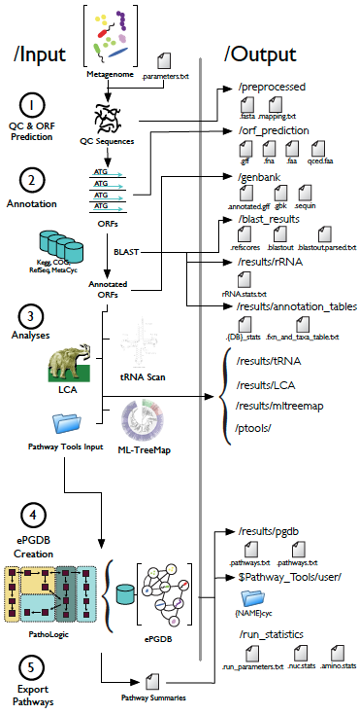
MetaPathways
A modular pipeline for constructing Pathway/Genome Databases from environmental sequence information
MetaPathways currently supports four “data products” including i) GenBank submission, ii) LCA, iii) MLTreeMap, and iv) ePGDBs with associated feature summary tables and GFF files
MetaPathways externalizes compute-intensive processes onto a user defined cluster using Sun Grid Engine or the Amazon elastic cloud
Notes:
Note: created a MetaCyc BLAST database! This improves pathologic performance.

Slide 18
MetaPathways
ePGDBs facilitate pathway-centric exploration of environmental sequence information using Pathway Tools and the MetaCyc web interface
Provides inference-based approach to metabolic reconstruction based on explicit computational rules to predict presence or absence of distributed metabolic networks
MetaPathways can be used with multi-molecular data sets (DNA, RNA or protein) sourced from cultured isolates, single-cells and natural or human engineered ecosystems
http://www.github.com/hallamlab/MetaPathways
http://hallam.microbiology.ubc.ca/MetaPathways
Notes:
Pyramid figure describing the different levels of PGDB hosted by under the BioCyc umbrella and the subsequent analysis that we did at each level. ePGDBs are suggested as an extension in level-4 of the pyramid.

Slide 19
ePGDB Navigation
Notes:
Pyramid figure describing the different levels of PGDB hosted by under the BioCyc umbrella and the subsequent analysis that we did at each level. ePGDBs are suggested as an extension in level-4 of the pyramid.

Slide 20
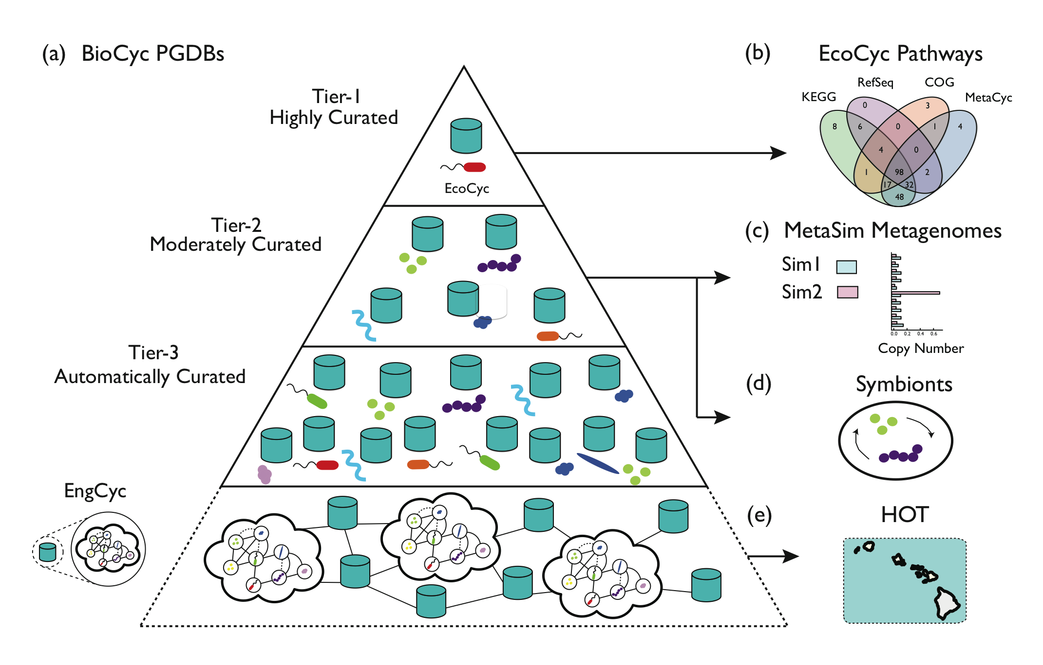
ePGDB Validation
Notes:
Pyramid figure describing the different levels of PGDB hosted by under the BioCyc umbrella and the subsequent analysis that we did at each level. ePGDBs are suggested as an extension in level-4 of the pyramid.

Slide 21
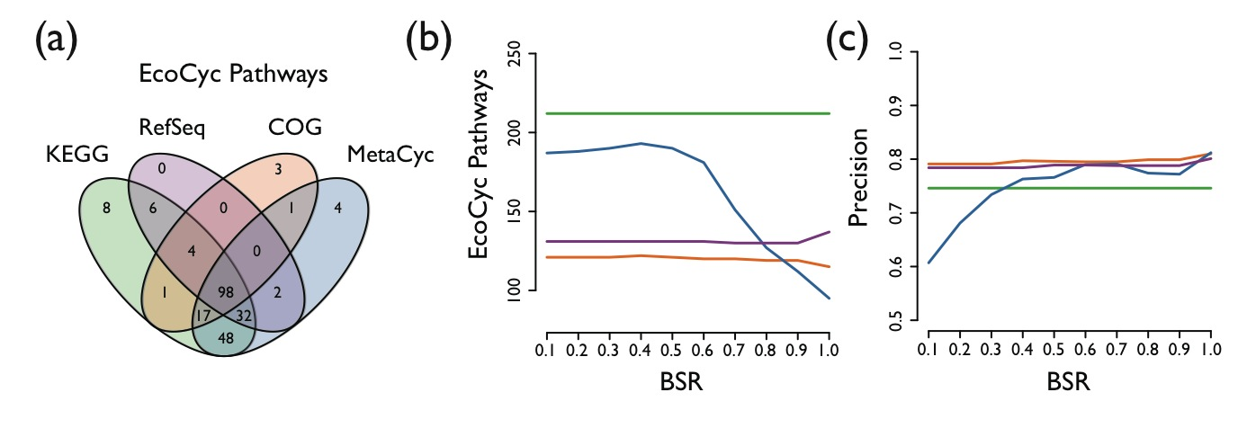
EcoCyc Pathways
  The number of E. coli pathways identified using the MetaCyc blast database decreases with increasing blast score ratio (BSR) cut-off while the others stay relatively constant. From this an optimal BSR between 0.4-0.6 can be inferred.
Notes:
Note: there are currently 300 base Pathways in the EcoCyc database as of March 3, 2013 (http://ecocyc.org/ECOLI/organism-summary?object=ECOLI)

Slide 22
MetaSim Pathways
Notes:
Summary of MetaSim analysis using Tier-2 PGDBs. Created two simulated metagenomes sim1 and sim2, sim2 having one taxa with a copy number much higher than the others. Total number of pathways suffers as a function of coverage and taxonomic distribution. Fortunately, specificity (type-1 errors) doesn't suffer much with different annotation schemes. At the same time sensitivity (type-2 errors) increases as a function of coverage and taxon distribution.

Slide 23
Synthetic Ecology
  The pathway (S-adenosyl-L-methionine cycle II) was identified by Pathway Tools in the simulated metagenome based on the combined contribution of two genomes (a + b).
Notes:
An illustration of distributed metabolism using the concatenated genome method with genomes from the tier-2 pgdbs.

Slide 24
Infering Trophic Interactions
  An ePGDB constructed for the Mealybug symbionts Tremblaya princeps and Moranella endobia predicted interpathway complementarity in essential amino acid biosynthetic pathways.
McCutcheon, J.P. and von Dohlen, C.D. “An interdependent metabolic patchwork in the nested symbiosis of mealybugs.” Current Biology, 2011, DOI: 10.1016/j.cub.2011.06.051

Slide 25
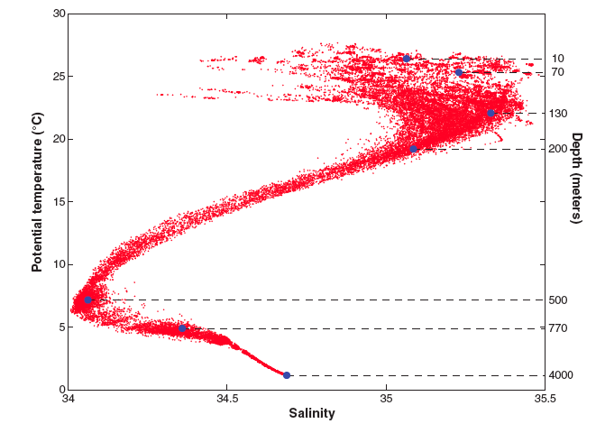
Hawaii Ocean Time Series (HOT)
DeLong et al. Community Genomics Among Stratified Assemblages in the Ocean’s Interior. (2006) Science 311
T. Danhorn, C. R. Young, E. F. Delong, Comparison of large-insert, small-insert and pyrosequencing libraries for metagenomic analysis, ISME J (2012), doi:10.1038/ismej.2012.35.
c1988-2012
Notes:
Temperature versus salinity (T-S) relations for the North Pacific Subtropical Gyre at station ALOHA (22-45’N, 158-W). The blue circles indicate the positions, in T-S ‘‘hydrospace’’ of the seven water samples analyzed in this study. The data envelope shows the temperature and salinity conditions observed during the period October 1988 to December 2004 emphasizing both the temporal variability of near-surface waters and the relative constancy of deep waters.

Slide 26
Environmental Sequence Information
HOT Sample Depth (m) | Description | Information | Sequencing Platform | Number of Sequences | Average Sequence Length | Protein Coding Sequences | Annotated Coding Sequences | MetaCyc Reactions | MetaCyc Pathways
25 | upper euphotic | DNA | Roche 454 | 623559 | 257 | 405613 | 214149 | 4138 | 864
75 | upper euphotic | DNA | Roche 454 | 673674 | 244 | 430689 | 222572 | 4052 | 854
110 | chlorophyll max | DNA | Roche 454 | 473166 | 270 | 336035 | 165775 | 4133 | 860
500 | mesopelagic | DNA | Roche 454 | 995747 | 276 | 714743 | 361193 | 4464 | 949
25 | upper euphotic | RNA | Roche 454 | 561821 | 248 | 234404 | 85781 | 3433 | 723
75 | upper euphotic | RNA | Roche 454 | 557718 | 239 | 203359 | 66855 | 3208 | 669
110 | chlorophyll max | RNA | Roche 454 | 398436 | 228 | 135107 | 36912 | 2549 | 532
500 | mesopelagic | RNA | Roche 454 | 479661 | 266 | 207465 | 71400 | 3034 | 641
  ePGDBs were generated for environmental sequence information (DNA and RNA) sourced from the HOT water column.

Slide 27
Core Pathways
Top 50
Notes:
The top 50 pathways by abundance from each the DNA and RNA samples and mapped them all together on the original dataset. ORF counts shown as a two way bar plot for each of the depths. The order of the pathways is based on the pathway hierarchy and then by abundance of the samples.

Slide 28
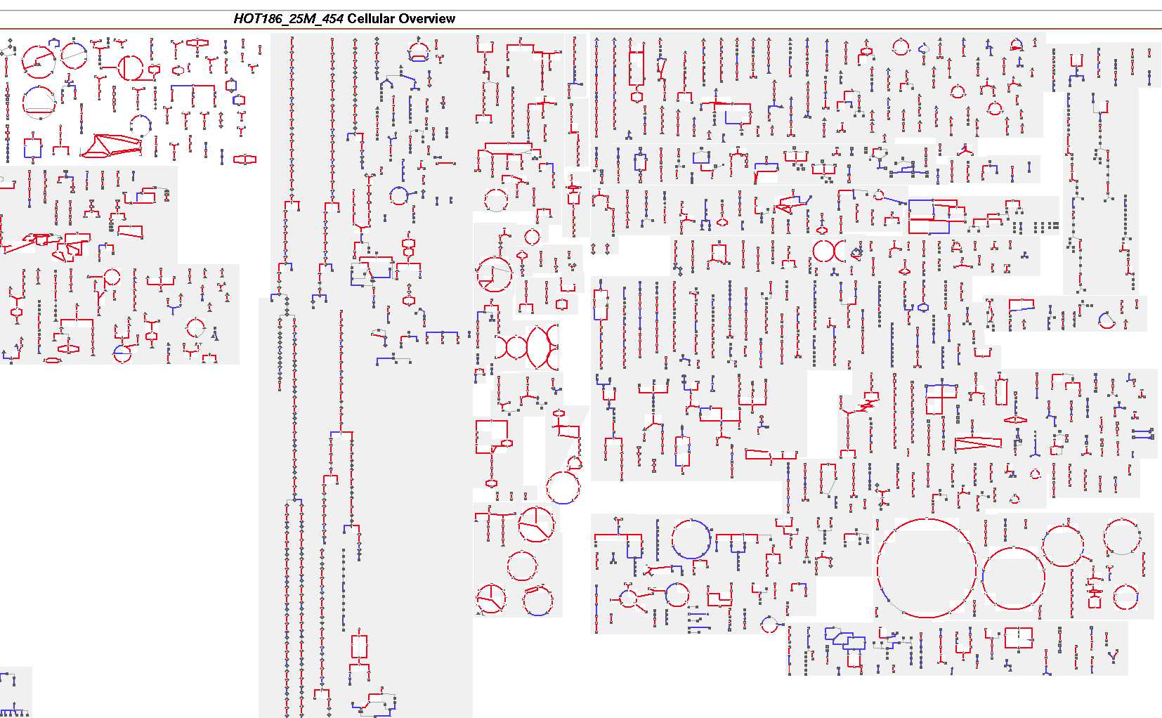
Cellular Overview
  Comparison of DNA (Blue) and RNA +DNA (Red) pathway predictions

Slide 29
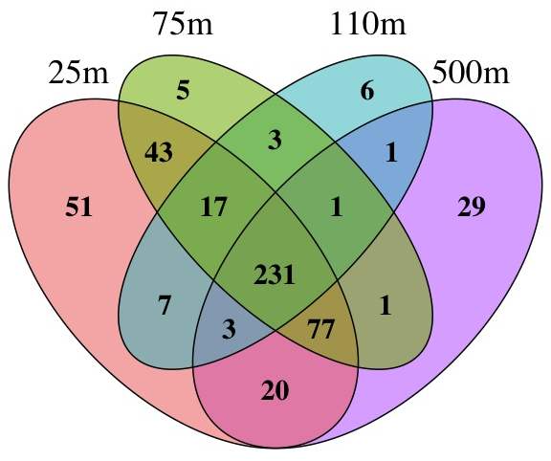
Pathway Partitioning
  Comparison of genetic potential and gene expression data in photic and dark ocean waters
Notes:
An alternative analysis of the sets of pathways isolates these distinct pathways in a more principled way. Niels Does R package for Venn Diagrams used to separate the sets. Union of this set determined and overlaid on the original RNA dataset sorting by the same way as before (pathway class and then overall abundance across all datasets shown).

Slide 30
Diagnostic Pathways

Slide 31
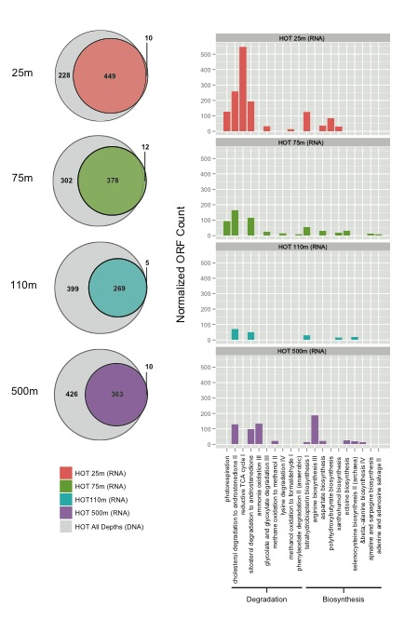
Cryptic Pathways
  For each depth interval, a small number of cryptic pathways were predicted in RNA that were not predicted in DNA data sets
  These pathways showed depth distributions consistent with niche-partitioning between sunlit and dark ocean waters

Slide 32
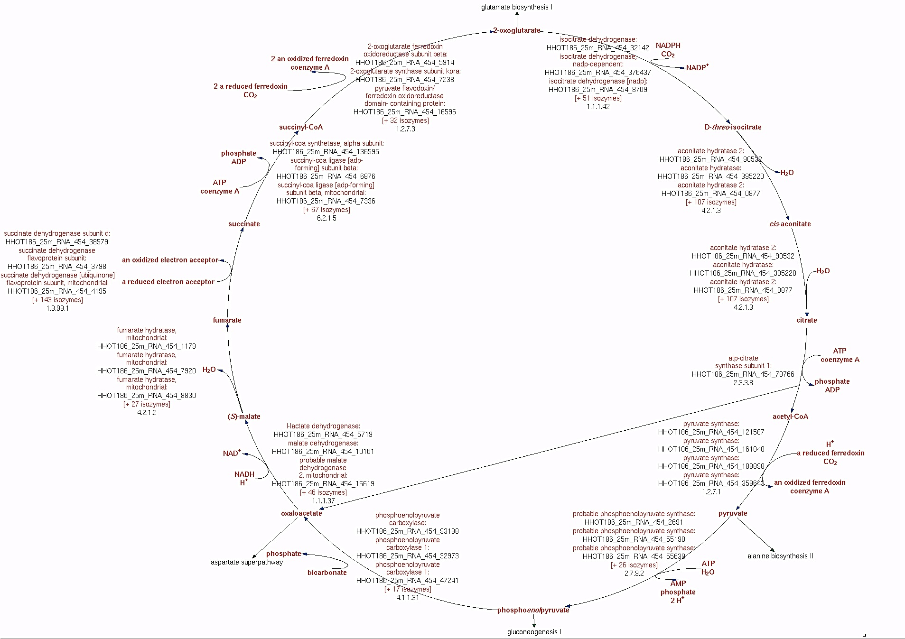
Known Hazards
  Missing ATP citrate lyase indicates false positive for rTCA

Slide 33
Things to Keep in Mind…
Pathologic cannot predict pathways not present in MetaCyc
Evidence for short pathways is hard to interpret
False positives due to shared enzymes in multiple pathways or incorrect annotations create hazards
Currently no taxonomic assignment or coverage information is mapped onto identified pathways
Limited functional validation for pathways in metagenomes

Slide 34
“One gene is many hypotheses”_{Anonymous}

Slide 35
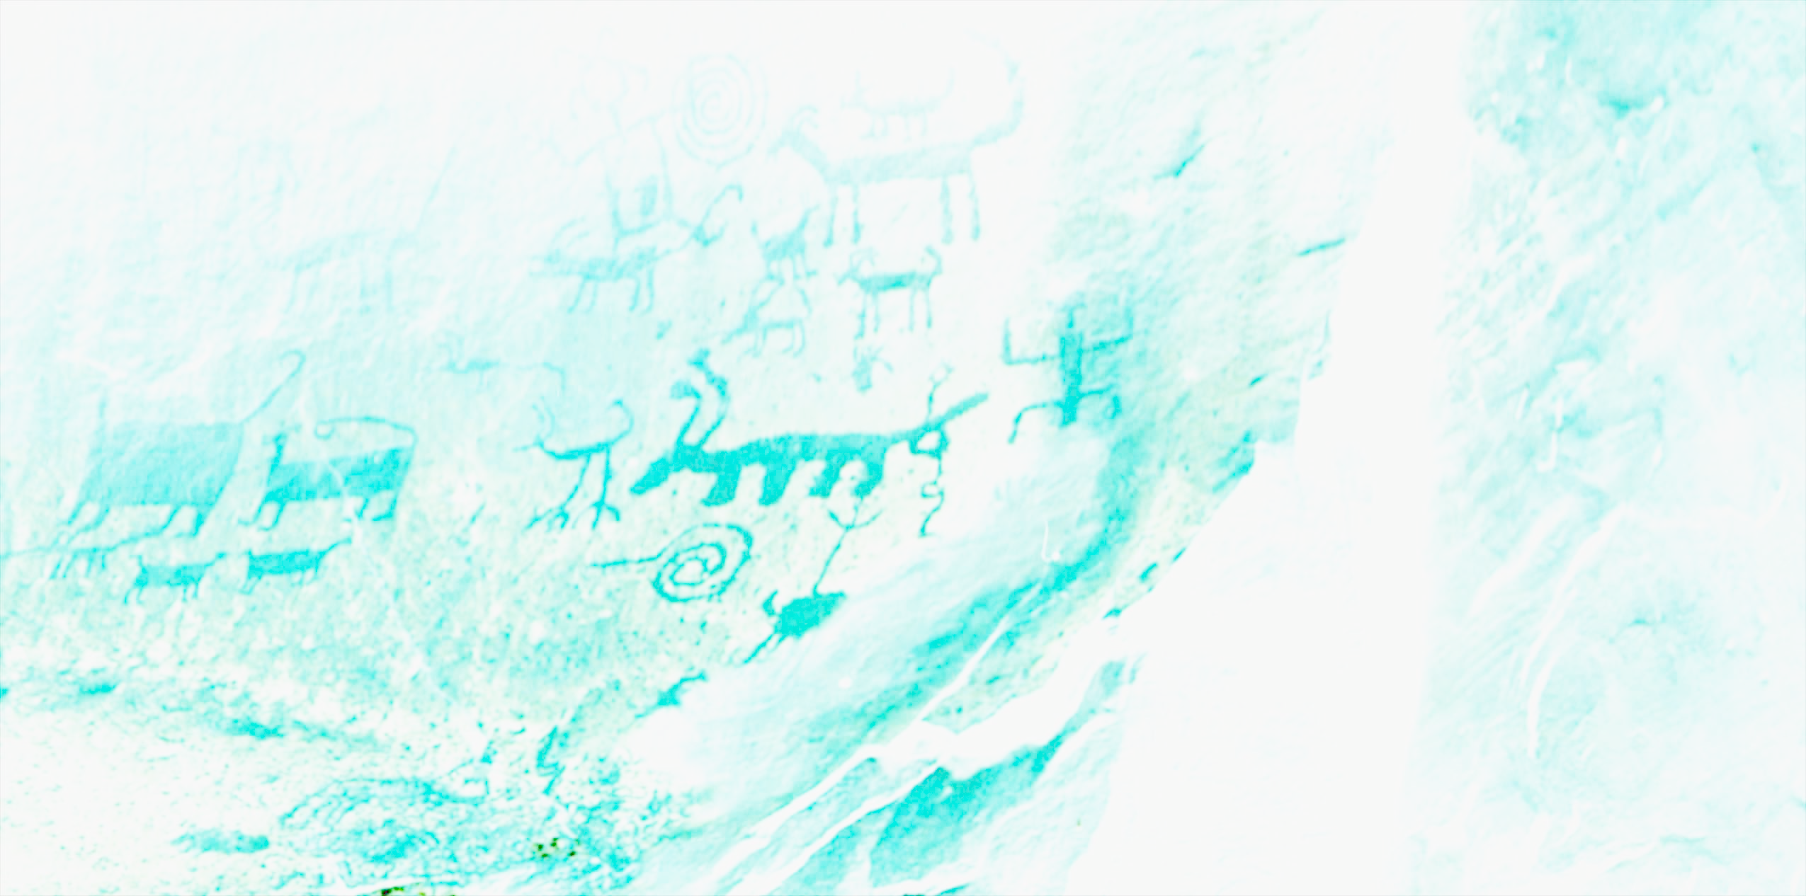







University of British Columbia
Maya Bhatia
Monica Torres Beltran
Annie Cox
Evan Durno
Diane Fairly
Esther Geis
Alyse Hawley
Aria Hahn
Niels Hansen
Sam Kheirandish
Kishori Konwar
Keith Mewis
Antoine Page
Melanie Scofield
Young Song
Nicole Sukdeo
Jody Wright
Elena Zaikova
SRI
Peter Karp
Tomer Altman
Institute for Ocean Sciences
Marie Robert
Robin Brown
Joint Genome Institute
Susannah Tringe
Tijana Glavina del Rio
Pacific Northwest National Laboratory
Angela Norbeck
Ljiljana Pasa-Tolic
Heather Brewer

