Slide 1
Expanded Representation of EC Numbers in Pathway Tools
Suzanne Paley
March 2013

Slide 2
Motivations
EC: Enzyme Commission system for identifying enzyme functionality
Multifunctional enzyme should have different EC# for each function
Old Pathway Tools representation:
Assumption: single function of an enzyme = single reaction
Each reaction was assigned a single EC#
An enzyme has EC#s derived from all reactions it catalyzes
Problems:
Enzyme Commission can assign multiple EC#s to same reaction due to different cellular roles, different substrate specificities, different cofactors, etc.
A single EC# can refer to multiple reactions due to substrate non-specificity, sub-reactions, etc.
1:1 mapping between EC#s and reactions was increasingly causing problems

Slide 3
New Representation (v. 16.5)
Reaction can have multiple EC#s
New EC-Numbers database
Object created for every EC# (and every EC class)
Contains name, synonyms, comments, citations from Enzyme Commission
Maintained byMetaCyc curators, loaded by every PGDB
Reaction object in a PGDB points to one or more EC# objects in EC-Numbers database
Link to EC# can be annotated as an “official” EC reaction
Official means it is part of the EC# definition from the Enzyme Commission
There can be additional “unofficial” reactions associated with an EC#, e.g. for alternate substrates, specific substrates, etc.
MetaCyc contains every EC reaction, other PGDBs contain a subset
Non-backwards-compatible change

Slide 4
Associating EC# With Enzyme
Enzymes not directly linked to EC#s – EC#s are inferred from reactions they catalyze
An enzyme must catalyze all “official” EC reactions for a given EC# in order to be associated w/ that EC#
May or may not catalyze “unofficial” EC reactions
If an enzyme catalyzes multiple reactions, it is preferentially associated with EC# that covers all the reactions, rather than EC#s of individual reactions

Slide 5
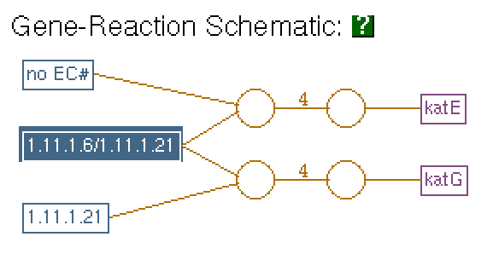
Example: 1.11.1.6/1.11.1.21
1.11.1.6 -- catalase
2H₂O₂ -> 2 H₂O + O₂
1.11.1.21 – catalase-peroxidase
2H₂O₂ -> 2 H₂O + O₂
2nd reaction uses generic electron acceptor
Catalase reaction assigned both EC#s
katE only catalyzes first reaction, inferred EC 1.11.1.6
katG catalyzes both reactions, inferred EC 1.11.1.21, but not 1.11.1.6

Slide 6
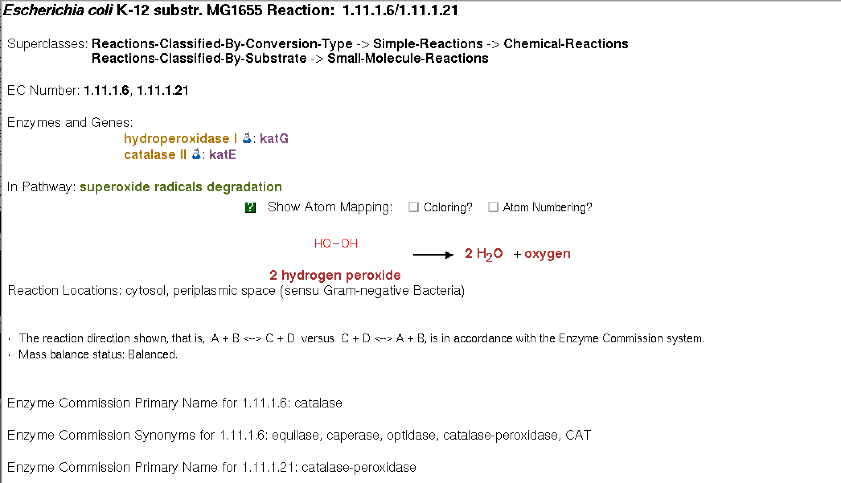
Catalase Reaction Page

Slide 7
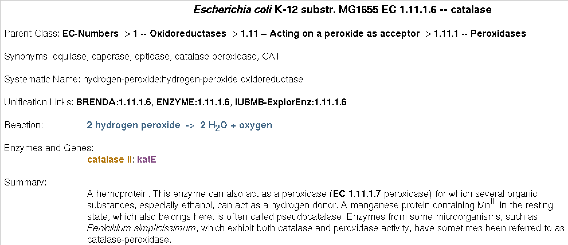
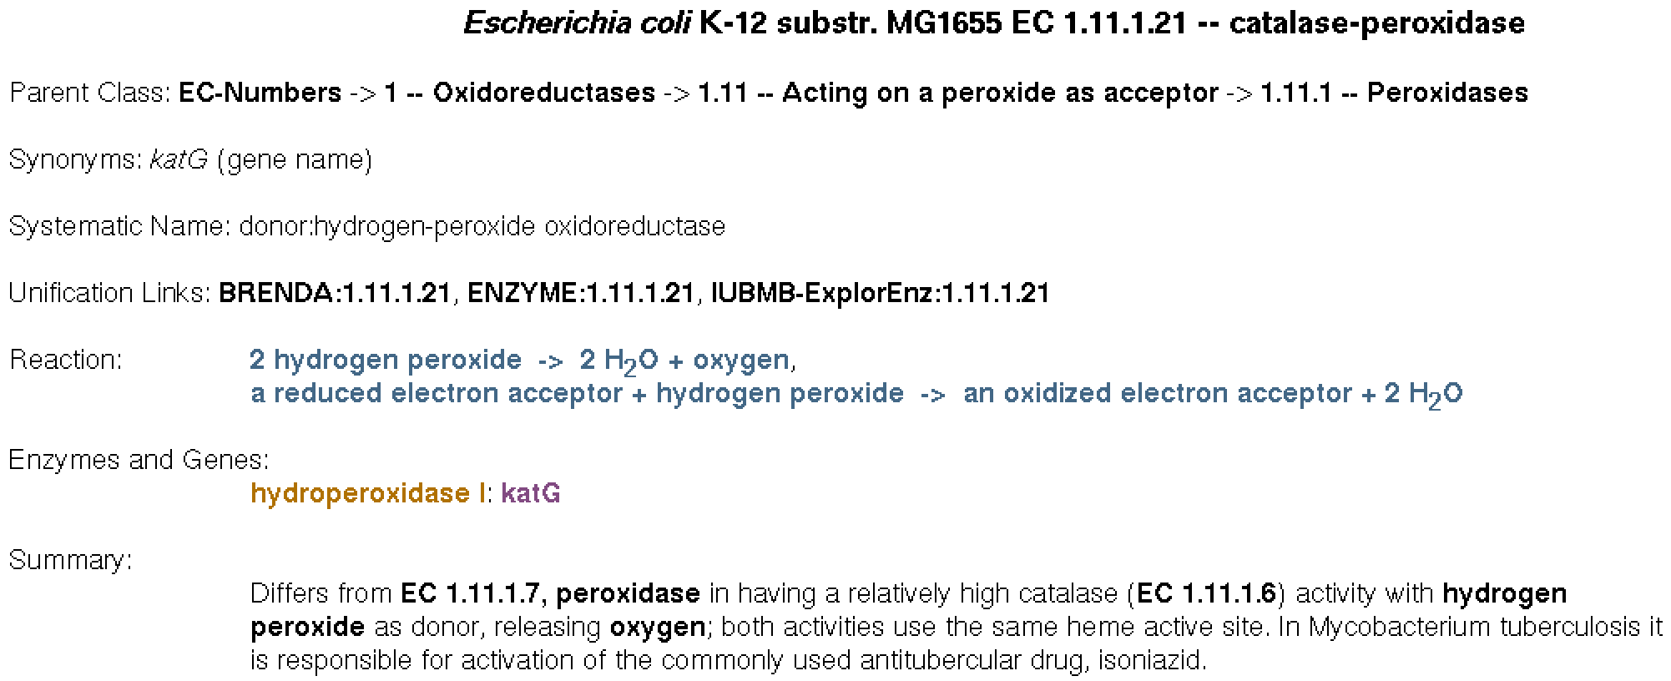
EC Number Pages

Slide 8
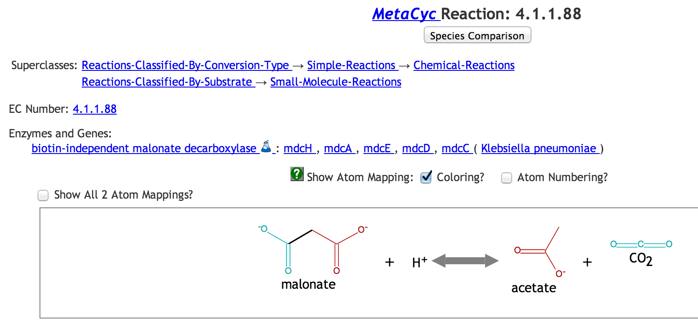
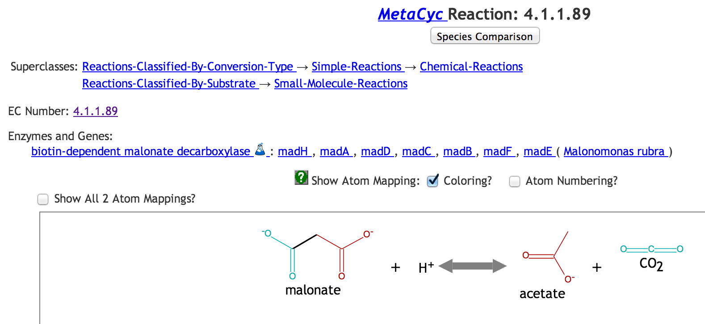
But…

Slide 9
Other Changes: Enzyme Kinetic Data
Kinetic parameters K_{m}, k_{cat}, V_{max}, specific activity associated with enzymatic-reaction
K_{m} also associated with particular substrate in enzymatic-reaction
Recent change: Now all parameters are also associated with substrate in enzymatic-reaction
Enables us to compute k_{cat}/K_{m} (catalytic activity)
Developed program to infer appropriate substrate for 400+ kinetic data values previously entered w/o substrate in EcoCyc and MetaCyc

